Slide 1


OPEA-based RAG on Intel® Gaudi with OpenShift AI

Slide 2

It’s not magic.
It’s math.
AI - Foundational concepts
All of the amazing things that AI and Generative AI can do all comes down to mathematical computation.
Compute intensive
Storage intensive
There are no small workloads
Quota attainment

Slide 3
Key Messages: Intel and Red Hat deliver open, standards-based RAG inferencing
Red Hat and Intel are members of Open Platform for Enterprise AI, an initiative focused on open source, enterprise AI solutions.
RAG databases dramatically improve the accuracy of inferencing results and are a key component of OPEA architecture.

Slide 4


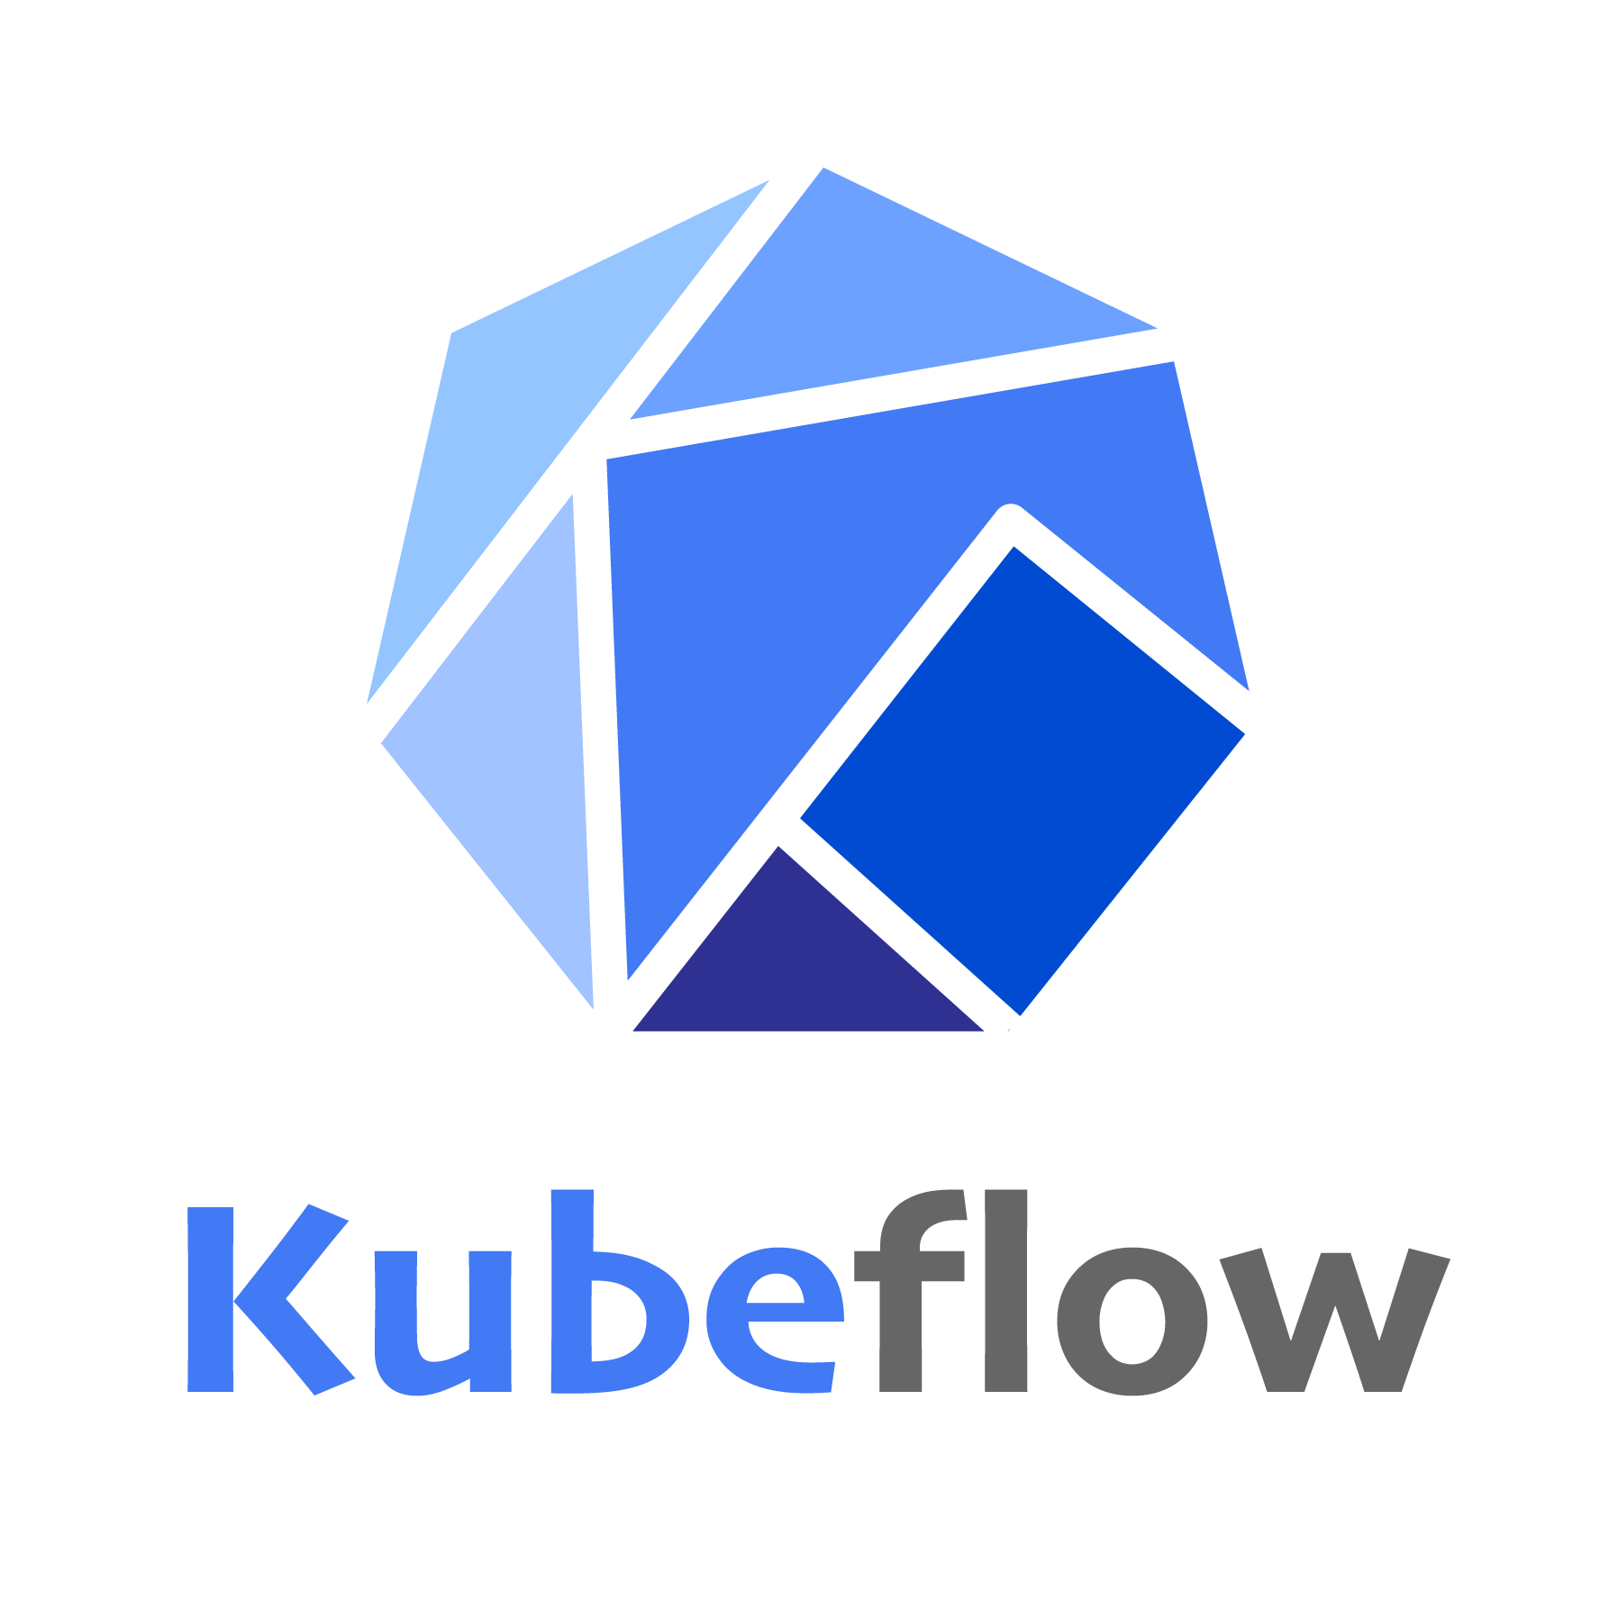

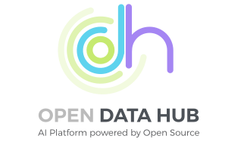


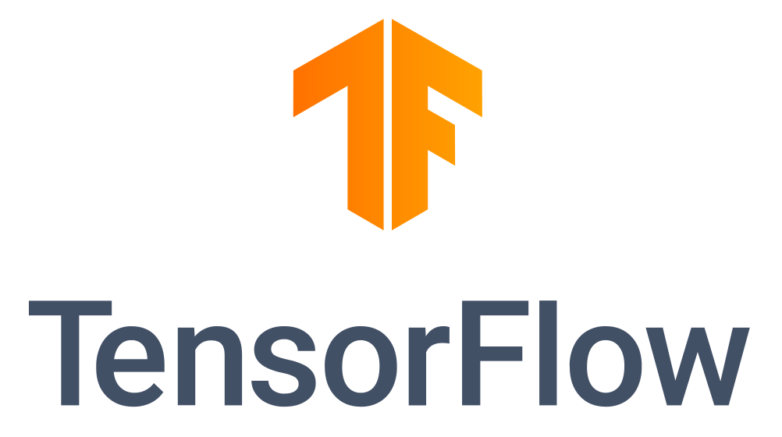

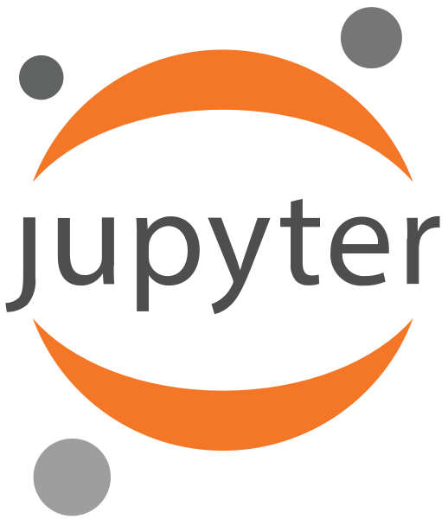
Red Hat value & strategy around AI
Open-source project to enterprise product
Services
Upstream projects
Integration projects
Product
CodeFlare
Platform
Notes:
What value does Red Hat provide specifically to your AI journey? We invest and participate in upstream community projects, the stack is then matured into the Open Data Hub project, and ultimately integrated into the Red Hat Openshift AI product. Openshift AI enables ootb bring-your-own-model use cases.
N community projects are curated into Open Data Hub "ODH" project. Red Hat is curates and participates in many AI/ML/DS community projects and packages them into the Open Data Hub project.
ODH project is curated into Red Hat OpenShift Artificial Intelligence "RHOAI" product
Both the project and product are installed via Operators
The are 5 categories of components that are modular
For GenAI, we are incubating in the ODH project:
Model Serving is the most mature
Model Training is the least mature
Beyond our product, we see ISVs completing the holistic pictures
Concretely, vector database
Co-develop with IBM research on open source infrastructure stack for all AI workflows
Mature the stack in upstream Open Data Hub and integrate into Red Hat OpenShift AI
Use Red Hat OpenShift AI as foundation layer for IBM watsonx.ai and Ansible Lightspeed with IBM Watson Code Assistant
Enable out-of-the-box “bring-your-own model” use cases
Infuse generative AI capabilities across the Red Hat portfolio as we did with Ansible Lightspeed

Slide 5








Dashboard Application
Data Science Projects
Admin Features
Model Registry
Object
Storage
Model Development & Training
Model Serving
Model Monitoring
Workbenches
Distributed workloads
Serving Engines
Performance metrics
- Minimal Python
- PyTorch
- CUDA
- Standard Data Science
- TensorFlow
- VSCode
- RStudio
- TrustyAI
KubeRay
Kserve
Model explainers
ModelMesh
CodeFlare
Quality metrics
Serving Runtimes
CodeFlare SDK
Data and model Pipelines
OpenVINO MS (built-in)
ISV images
Caikit/TGIS (built-in)
Custom images
Custom
OpenShift
Operators
OpenShift
GitOps
OpenShift
Pipelines
OpenShift
ServiceMesh
OpenShift
Serverless
Prometheus
Operating system

Slide 6


Red Hat Summit
Chat Bot
Powered by Llama 2 with RAG
on OpenShift AI
Accelerated by Gaudi 2

Slide 7

Chatbots powered
by LLMs and RAG offer advanced conversational capabilities
They combine the depth of pre-trained language understanding with the ability to pull in relevant information from external sources.

Slide 8
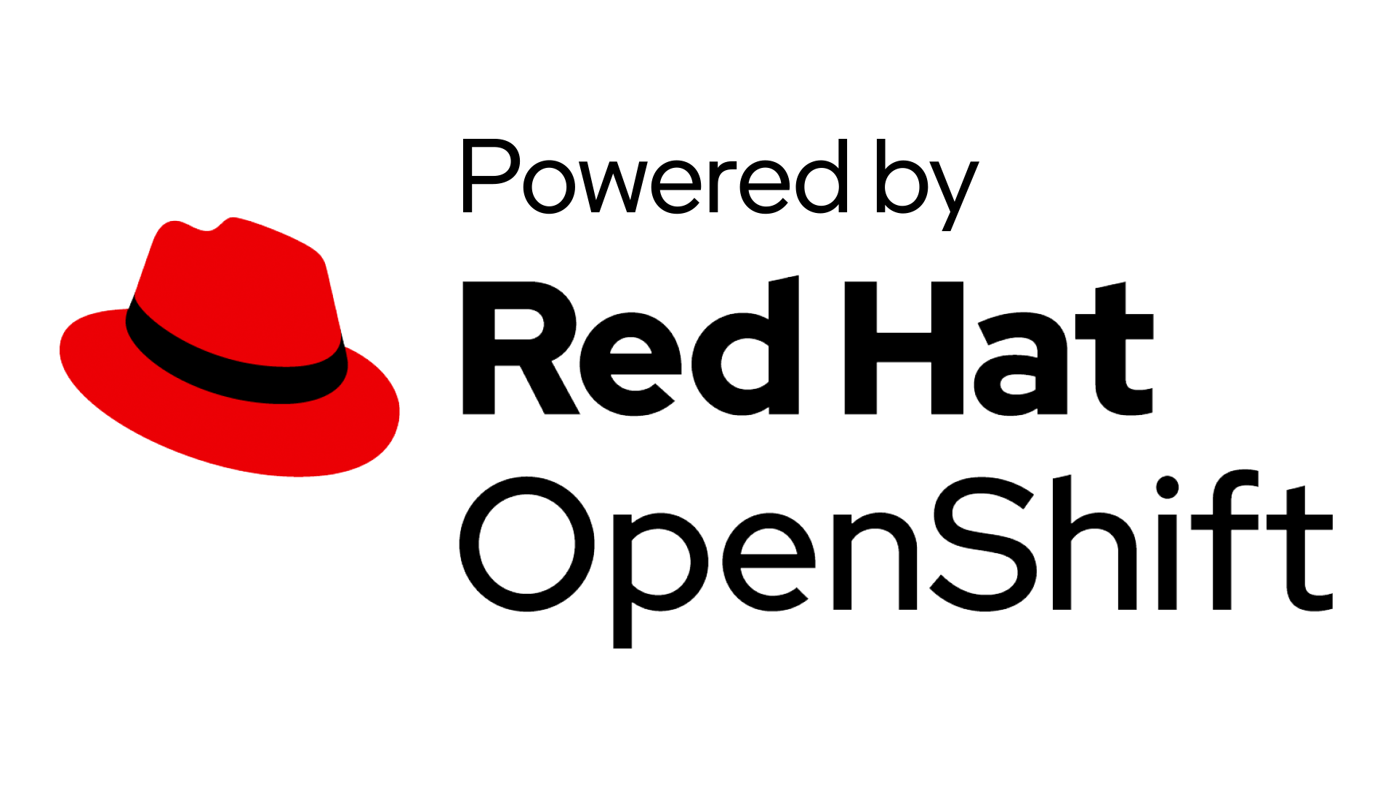





Demo Design Diagram
Documents
OpenShift AI
Database
Query
RAG
Backend
Request
Llama 2 Server
Model
Workbench
Response
User
Interface
Model
Developer
Response
Model
User
Backend
without
RAG
Llama 2 Server
S3-like
Storage
Request
Query
Response
Model
https://github.com/opea-project/GenAIExamples/tree/main/ChatQnA

Slide 9
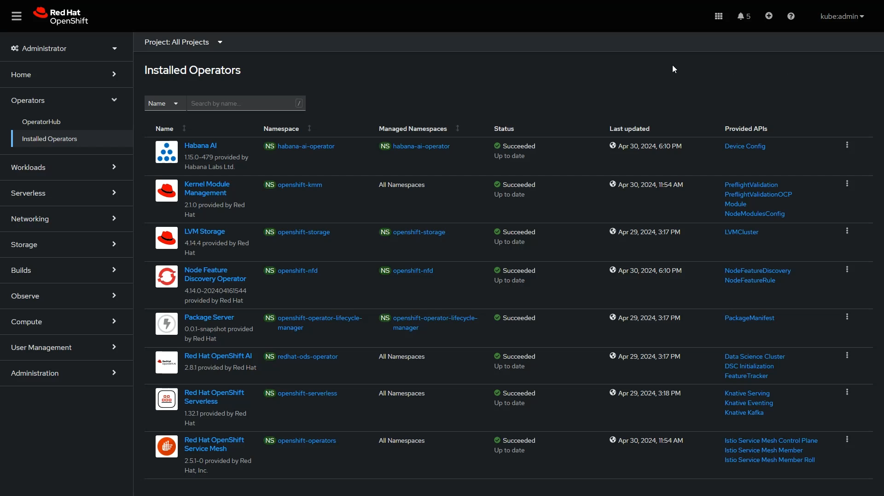
Operators are necessary for
Intel® Gaudi® to run properly on the
Red Hat ® OpenShift platform.

Slide 10
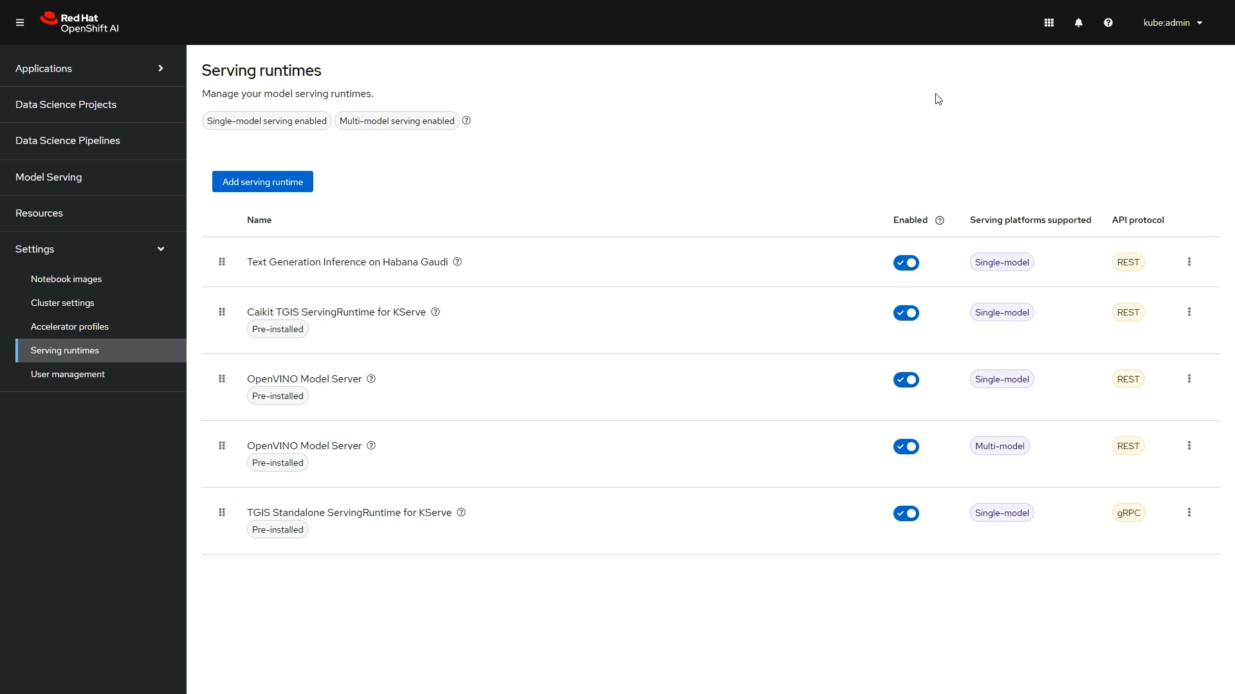
To accelerate your OpenShift AI model with Intel® Gaudi® 2,
you need a suitable Serving runtime

Slide 11
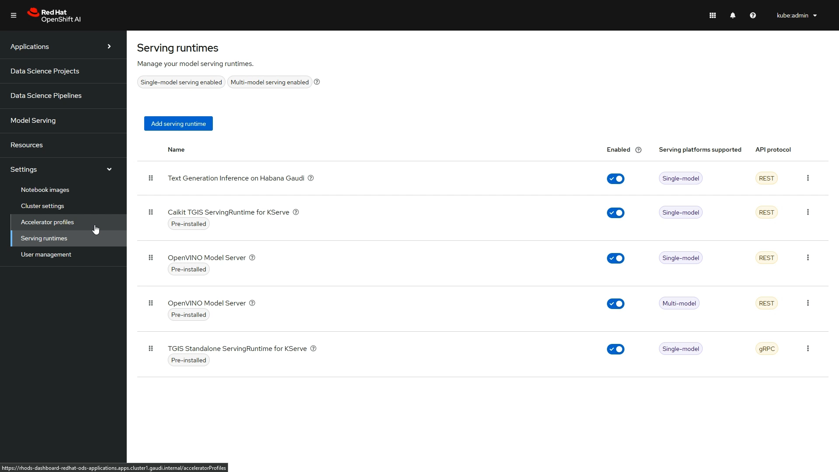
and an adequate
Accelerator profile.

Slide 12
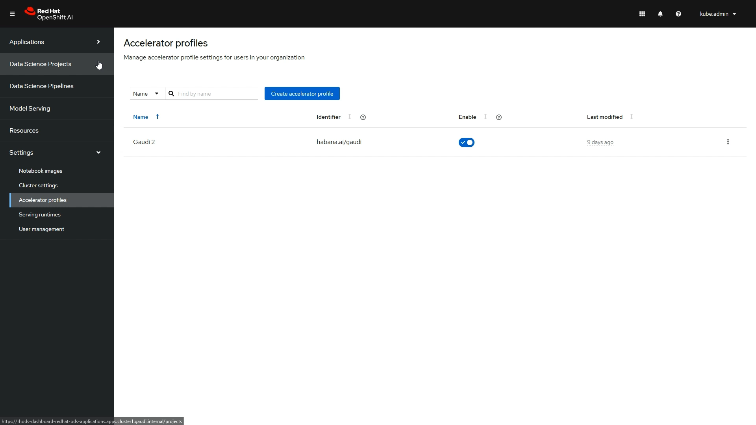
Store you model in
the S3 storage.
Deploy the model using
OpenShift AI.
Develop your model using OpenShift AI workbench.

Slide 13
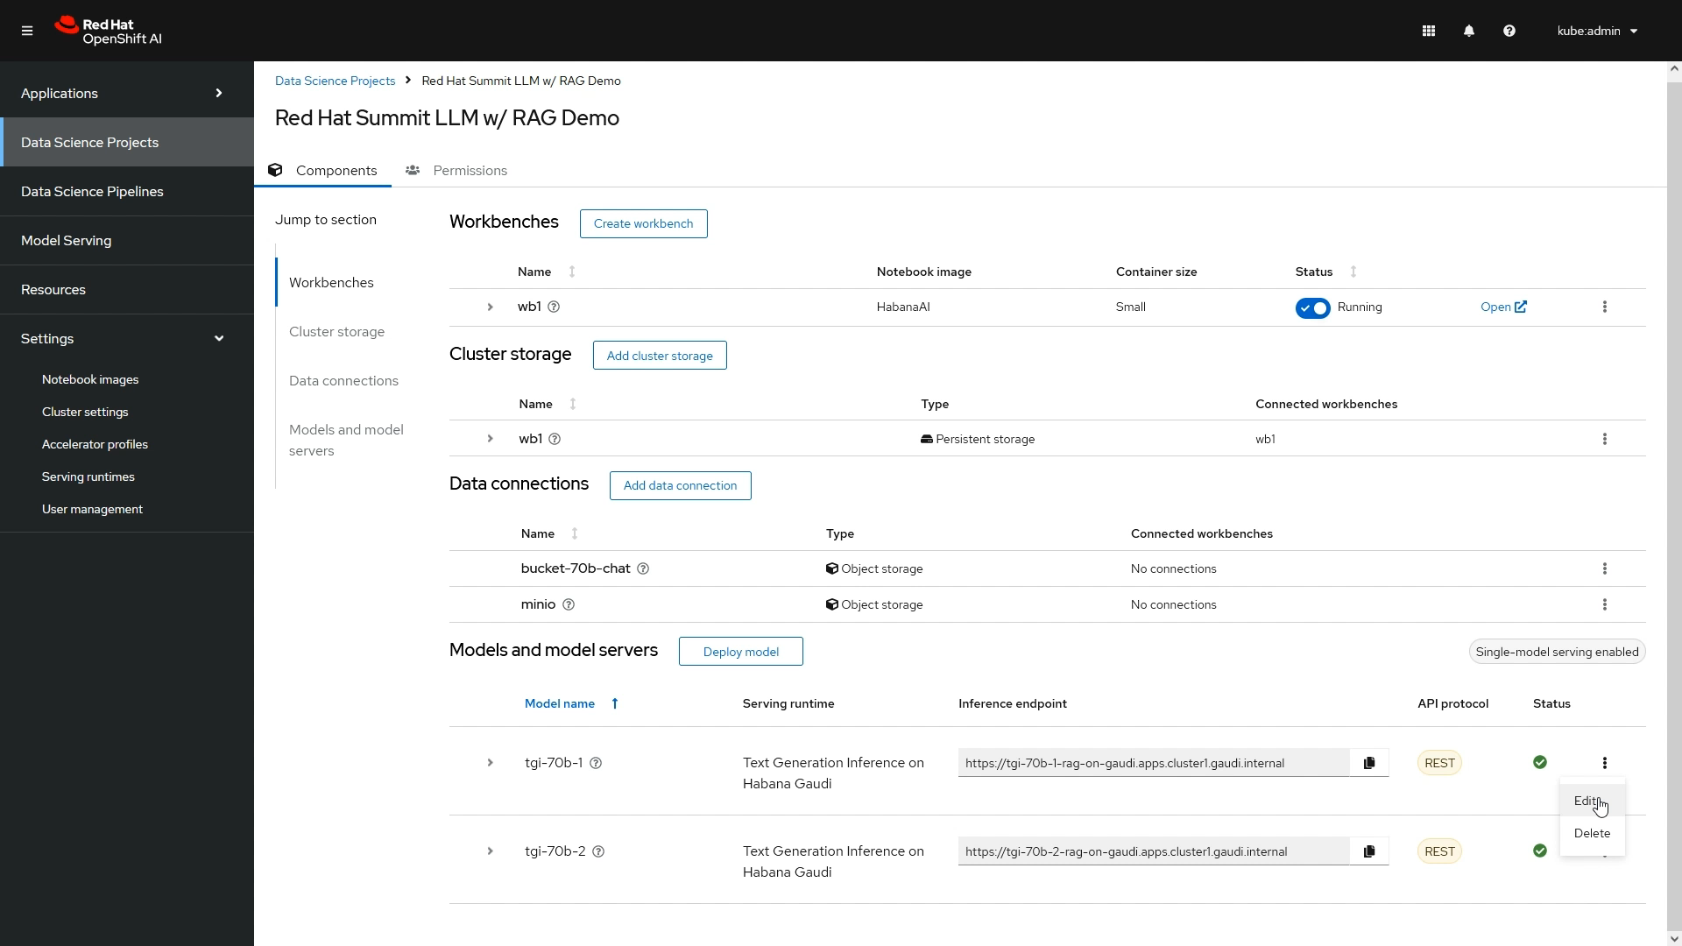
Llama models used in the
example runs with four
Intel® Gaudi® 2 accelerators each.

Slide 14
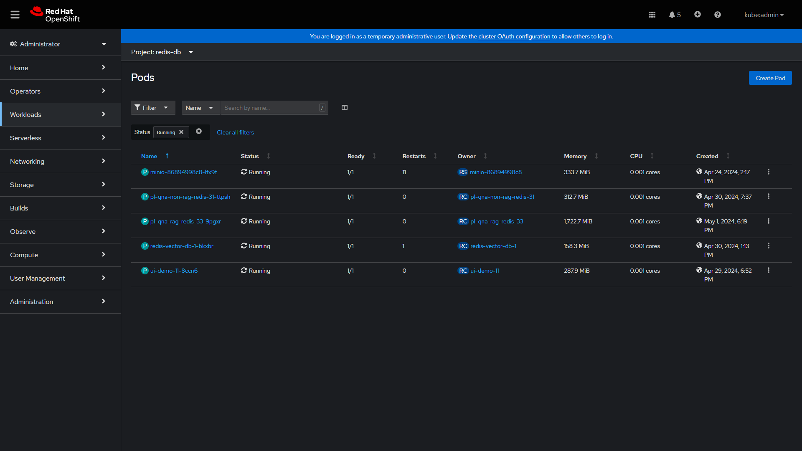
There are four more applications deployed for the demo purposes.

Slide 15
Two backends handle
the business logic for RAG
and non-RAG approach.

Slide 16
Redis database for RAG.

Slide 17
The UI to interact
with the model.

Slide 18
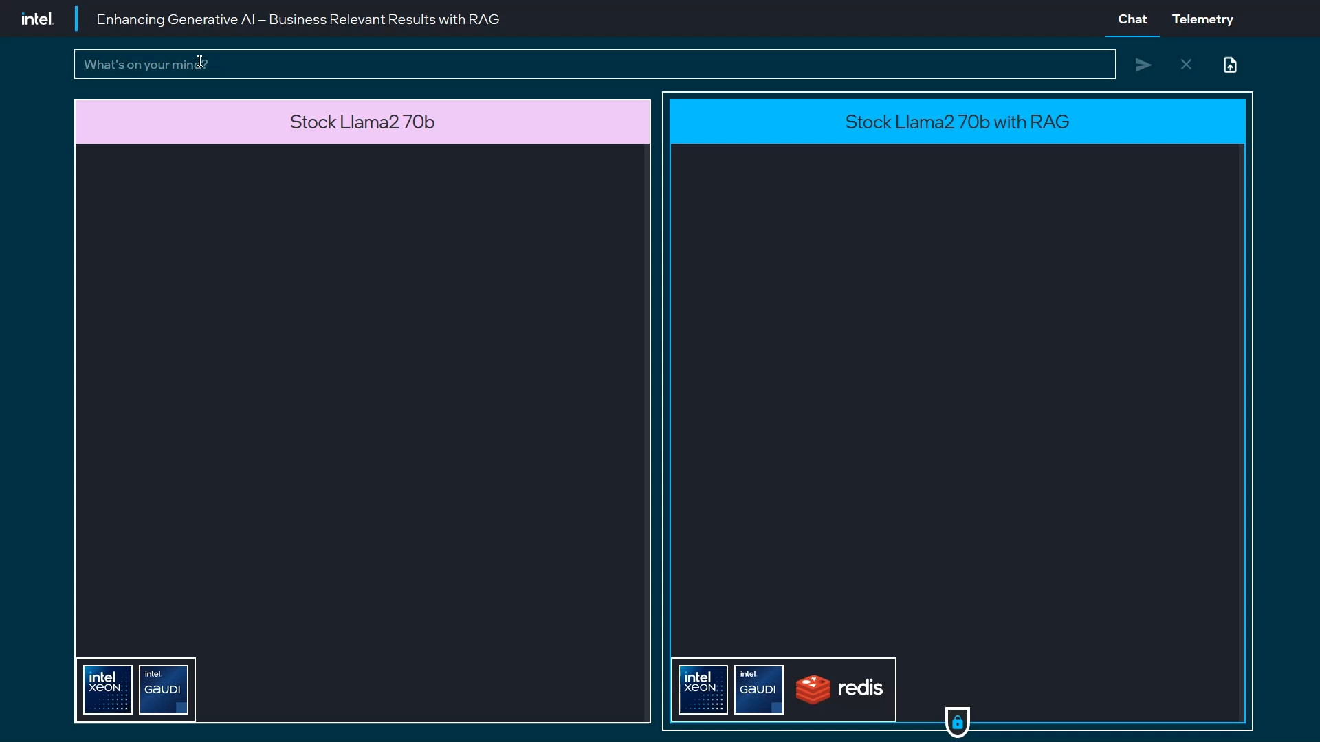
but after a while it is obvious that the non-RAG chat is struggling answering questions about
Red Hat Summit 2024.
RAG chat is aware of the context, so its responses are different from the beginning of this conversation.
At first it may seem that both chats do a relatively good job,

Slide 19
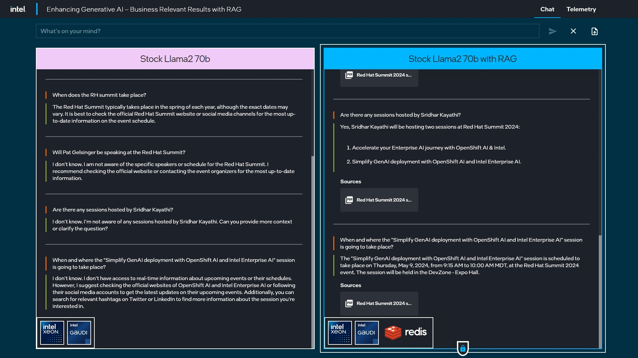
The non-RAG chat tries to hallucinate an agenda for the session instead of precisely answering the question.

Slide 20





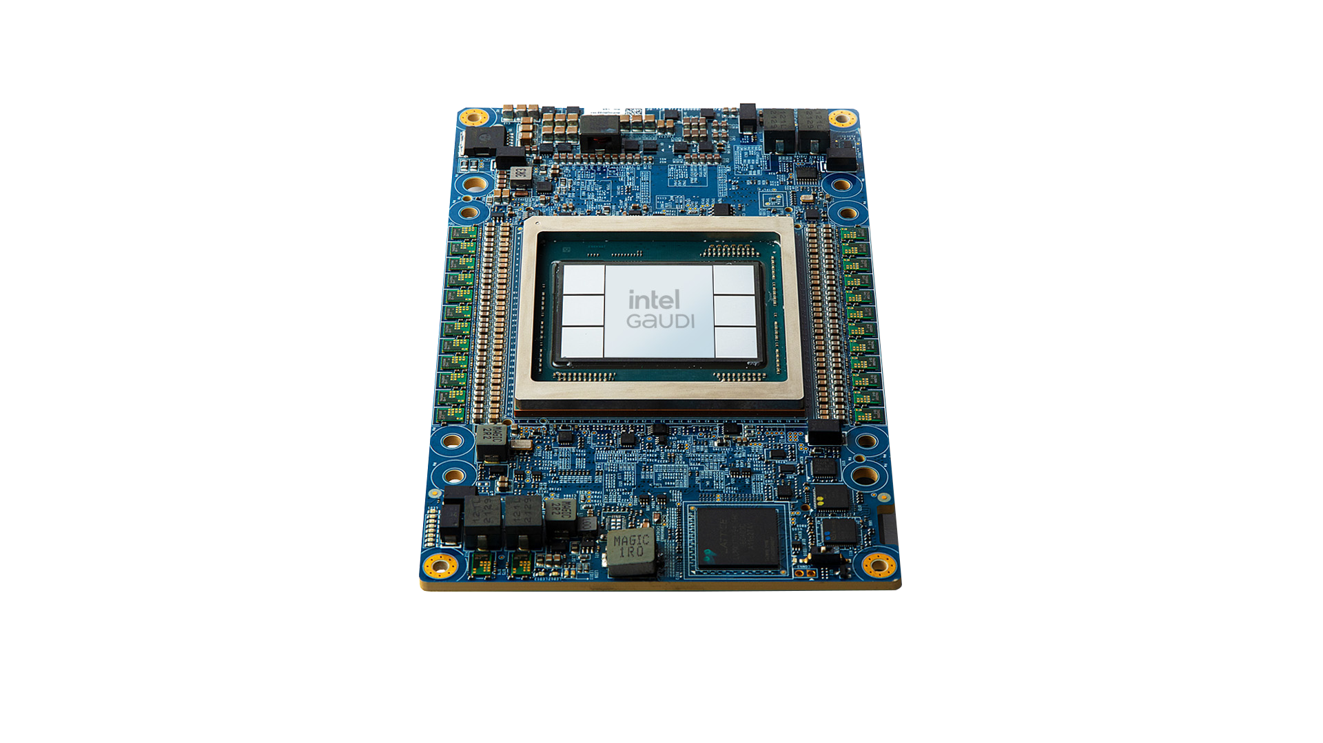



Information flow diagram – RAG process & inference
Inputs
Retrieval Augmented Generation
Inference
Output
User
Query
Embedding
Storage
(vector DB)
Relevant
Data
Extraction
Prompt
Building
Inference
LLM Model
Response
Documents
Extraction
Chunking
Embedding

Slide 21
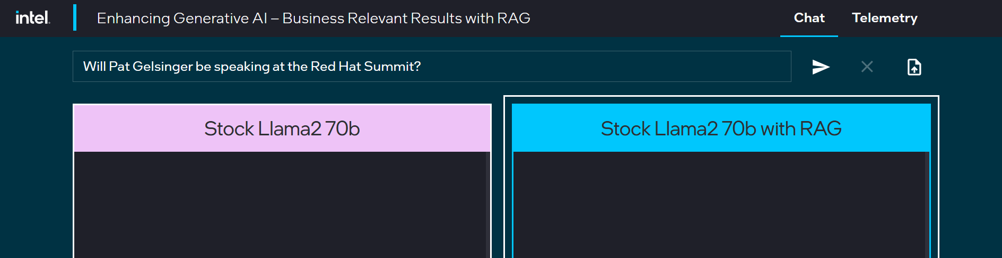
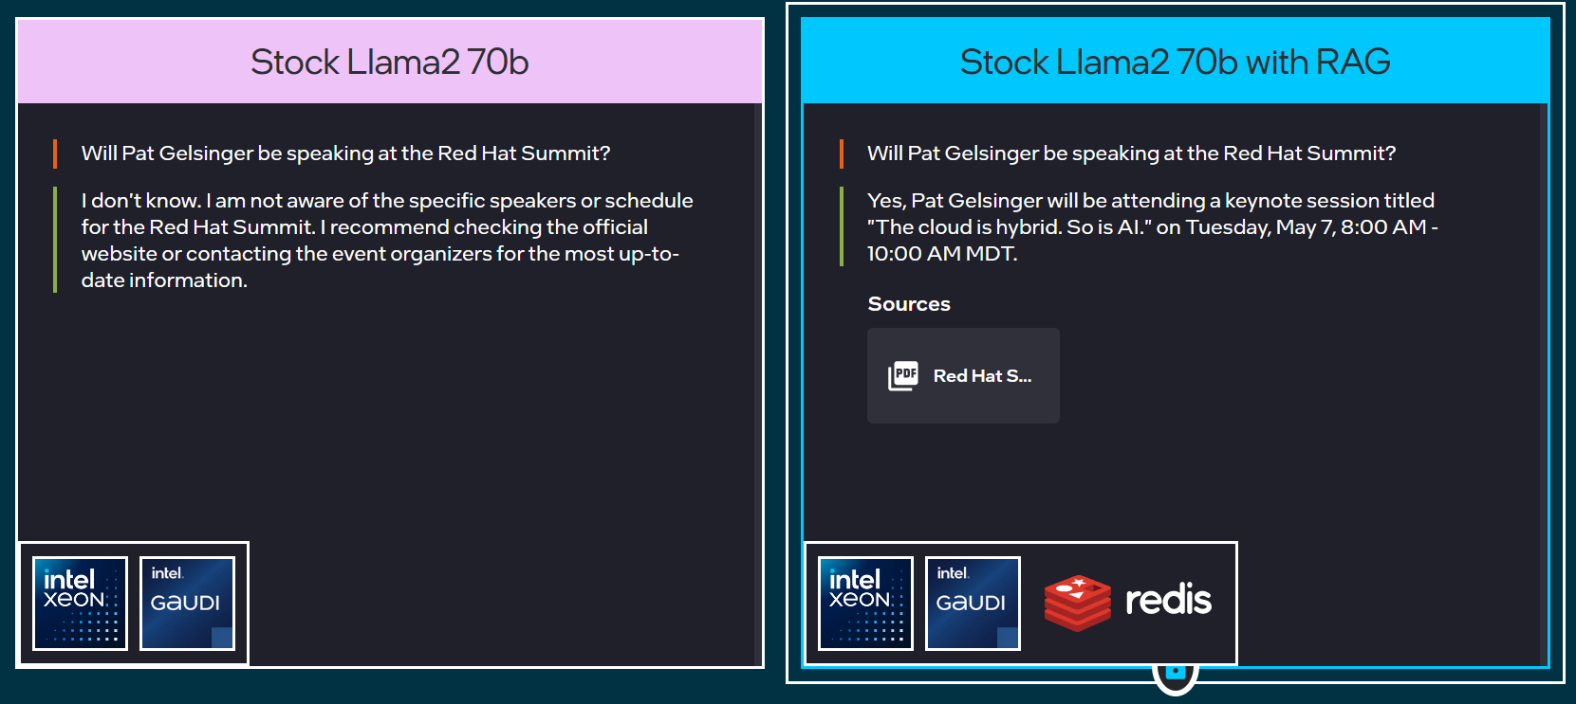
RAG Trained LLM (Intel® Gaudi® AI Accelerator)
Prompt
Gaudi Cluster
Fraud
Red Hat® OpenShift Cluster with Gaudi node

Slide 22
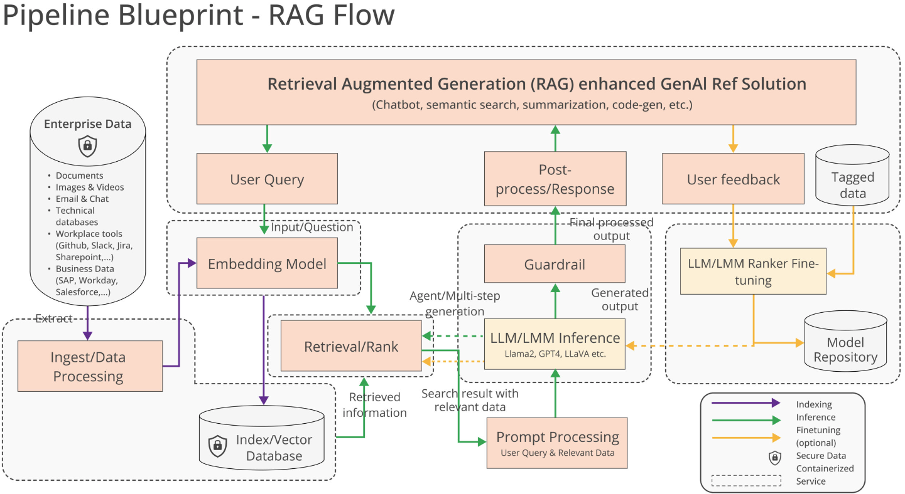
Pipeline Blueprint – RAG Flow

Slide 23





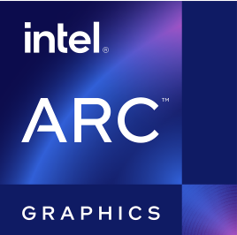
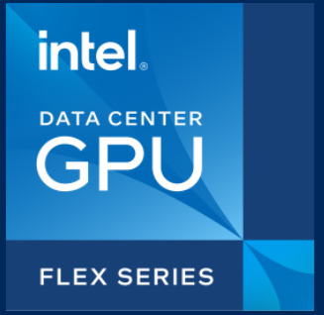
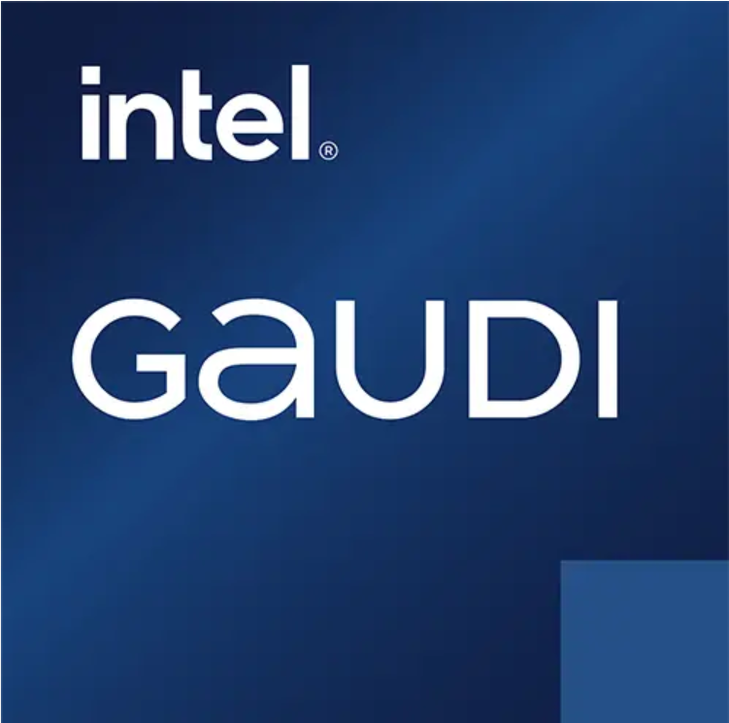
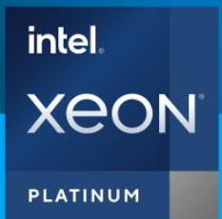






OPEA with OpenShift AI
RAG Workloads
Other AI/ML Workloads
RAG Workflow
Dashboard Application
OpenShift Operator
RAG Framework Building Blocks
Model Development & Training
Model
Serving
Model
Monitoring
Prompt Engines
Database & Storage
Foundation Models
RAG Apps Framework
Model Serving Runtime
…
One Click
Deployment
Instantiating
(Contributing & Implementing)
Customers Enterprise Infrastructure
Cloud Native AI Building Blocks
Prometheus
DRA
Confidential Computing
Scalability
OpenShift
Pipelines
OpenShift
ServiceMesh
Scheduler enhancement
Metrics
…
Red Hat Ansible
Intel AI accelerator
software provisioing
OPEA makes OpenShift AI GenAI Richer
OpenShift AI makes OPEA more enterprise ready
Notes:
The slide is summarized from
https://github.com/opea-project/GenAIExamples/releases/tag/v0.1.0
Open Platform For Enterprise AI (opea.dev)
https://github.com/intel/intel-technology-enabling-for-openshift
GenAI/RAG/LLM Framework including but not limited
Notes: Name from Open Platform For Enterprise AI (opea.dev), might change in the future
LLM Apps Framework
RAG Foundation Models
Database & storage
prompt engines
LLM Serving Runtime
** Cloud Native Composable Building Blocks including but not limited
Notes: Name might change in the future
DRA
Metrics (ToP/Power/etc) based schedule
Auto scalability
Confidential Computing
Efficient
Harnesses existing infrastructure, the AI accelerator or other hardware of your choosing.
Seamless
Integrates with enterprise software, with heterogeneous support and stability across system & network.
Open
Brings together best of breed innovations and is free from proprietary vendor lock-in.
Ubiquitous
Runs everywhere through a flexible architecture built for cloud, data center, edge and PC.
Trusted
Features a secure enterprise-ready pipeline and tools for responsibility, transparency, and traceability.
Scalable
Access to a vibrant ecosystem of partners to help build and scale your solution.

Slide 24
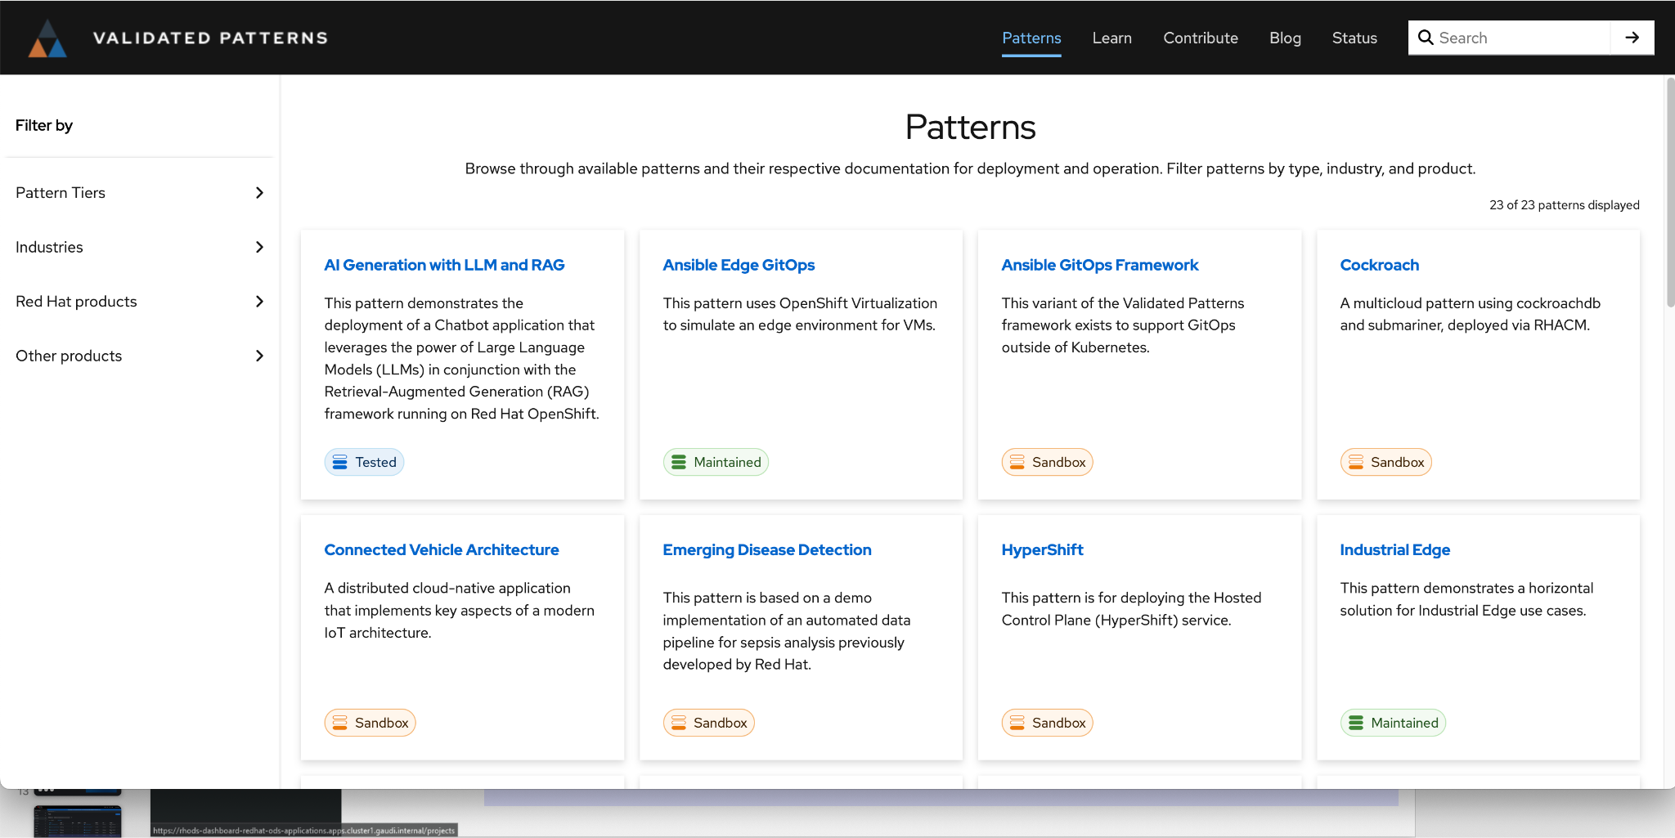
Validated Patterns
Validatedpatterns.io
Repeatable templates and guides help businesses accelerate projects and increase ecosystem mindshare

Slide 25
Visit
opea.dev
website to learn more about
Open Platform
for Enterprise AI

Slide 26


