Slide 1
OPEA Project Community Update
July 16, 2024

Slide 2
Antitrust Policy Notice
Linux Foundation meetings involve participation by industry competitors, and it is the intention of the Linux Foundation to conduct all of its activities in accordance with applicable antitrust and competition laws. It is therefore extremely important that attendees adhere to meeting agendas, and be aware of, and not participate in, any activities that are prohibited under applicable US state, federal or foreign antitrust and competition laws.
Examples of types of actions that are prohibited at Linux Foundation meetings and in connection with Linux Foundation activities are described in the Linux Foundation Antitrust Policy available at http://www.linuxfoundation.org/antitrust-policy. If you have questions about these matters, please contact your company counsel, or if you are a member of the Linux Foundation, feel free to contact Andrew Updegrove of the firm of Gesmer Updegrove LLP, which provides legal counsel to the Linux Foundation.

Slide 3
Agenda
Our Growing Partner Community
A look at OPEA Governance
Establishing Working Groups
Contributing: Code and More
Social Media Presence

Slide 4


























OPEA Partners
Partners as of July 8

Slide 5
OPEA Project Governance
Technical direction, decisions, and oversight by Technical Steering Committee
  Initial TSC membership is made up of OPEA partners
  TSC members select Chair by majority vote
Maintainers and Contributors
  Initial Maintainers are all Intel employees
  Maintainers select new Maintainers by majority vote based on record of positive contributions to the project
Inbound code contributions under Apache 2.0 license
…

Slide 6
OPEA Technical Steering Committee
Name | Title | Company
Amr Abdehalem | SVP, Head of Cloud Platforms | Fidelity
Malini Bhandaru | Senior Principal Engineer | Intel
Nathan Cartwright | Chief Architect - AI | CDW
Justin Cormack | CTO | Docker
Ke Ding | Senior Principal AI Engineer | Intel
Robert Hafner | Senior Principal Architect | Comcast
Steven Grubb | Senior Principal Engineer | Red Hat
Logan Markewich | Founding Software Developer | LlamaIndex
Melissa McKay | Head of Developer Relations | JFrog

Slide 7
Role of TSC
Per the charter
coordinating the technical direction of the Project;
approving project or system proposals (including, but not limited to, incubation, deprecation, and changes to a sub-project’s scope);
organizing sub-projects and removing sub-projects;
creating committees or working groups (for example, an executive or architectural committee or end-user advisory committee) to support the Project;
appointing representatives to work with other open source or open standards communities;
establishing community norms, workflows, issuing releases, and security issue reporting policies;
approving and implementing policies and processes for contributing (to be published in the CONTRIBUTING file) and coordinating with the series manager of the Project (as provided for in the Series Agreement, the “Series Manager”) to resolve matters or concerns that may arise as set forth in Section 7 of this Charter;
discussions, seeking consensus, and where necessary, voting on technical matters relating to the code base that affects multiple sub-projects; and
coordinating any marketing, events, or communications regarding the Project.

Slide 8
Establishing Working Groups
End User: Chartered to develop, organize and communicate real-world challenges, use cases, and best practices to help drive OPEA requirements and development and enable the end user community to get the most out of OPEA. (Facilitated by: Dave Florey)
Evaluation: Chartered to establish standardized metrics for evaluating the performance, safety, trustworthiness, and scalability of the RAG framework. This evaluation will cover both the complete flow and each individual component. (Facilitated by: Padma Apparao)
Research: Chartered to create innovation roadmap for OPEA and contribute to making it cutting-edge and appealing to users. (Facilitated by: Oren Pereg)
Security: Chartered to bring a security-first approach to OPEA. We coordinate to apply best practices from OpenSSF as well as new security technologies from the Confidential Computing Consortium. (Facilitated by: Dan Middleton)
Marketing & Communication: Chartered to grow the OPEA developer community through user feedback and contributions to media awareness and technical content development (Facilitated by: Rachel Roumeliotis)

Slide 9
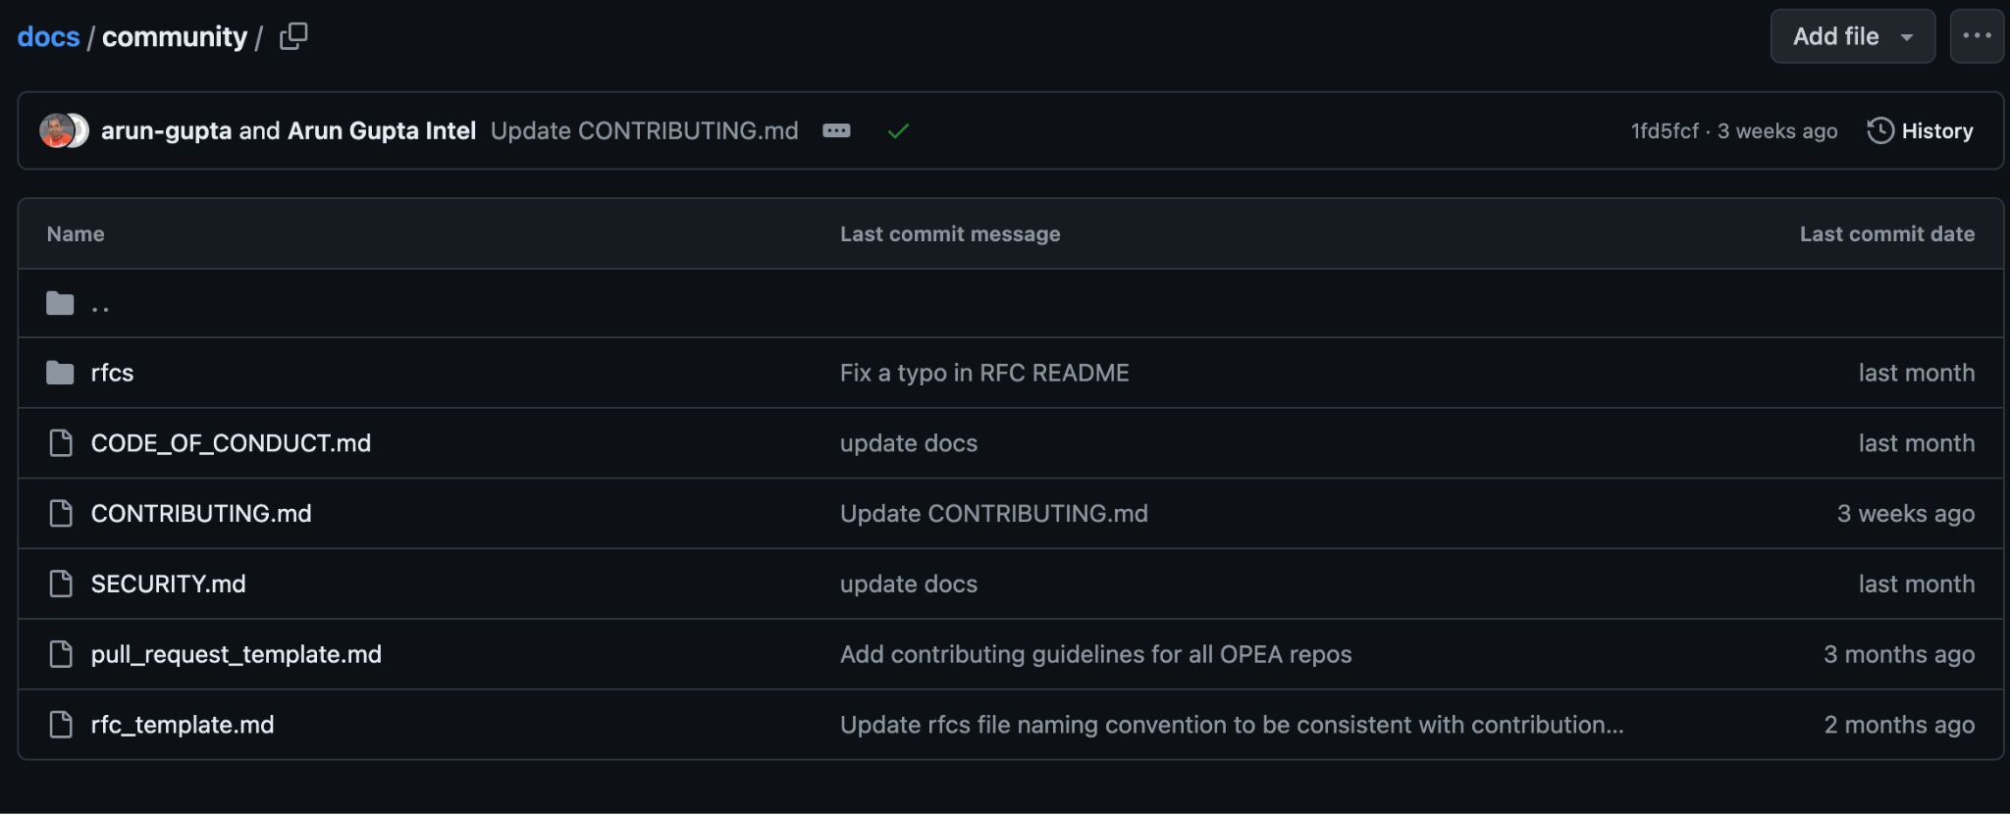
Community & Contributing
https://github.com/opea-project/docs/tree/main/community

Slide 10
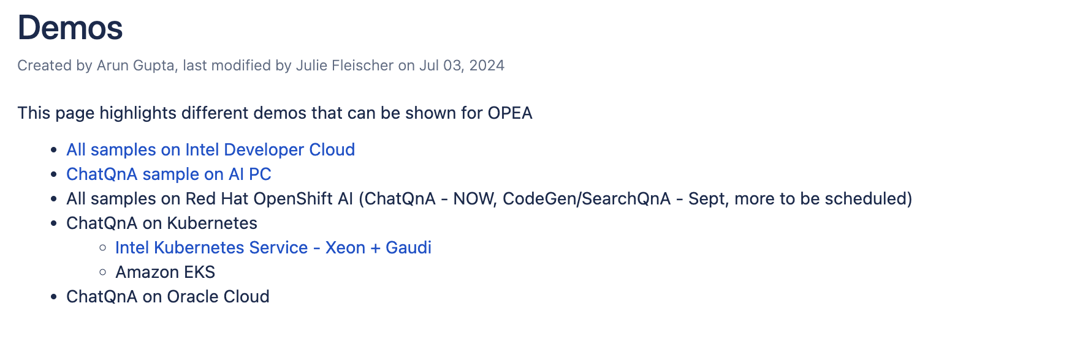
A Home for Demos
https://wiki.lfaidata.foundation/display/DL/Demos

Slide 11
Beyond Code: Looking for OPEA Content
Types of content​
Thought leadership​
Technical deep dives​
Technology enables business outcomes​
Use cases​
Written Interviews​
Podcasts​
Partner-focused
3rd-Party news sites ​​
TechCrunch​
ZDNet​
TechRepublic​
Datanami​
SiliconAngle​
InfoWorld​
SDTimes
Podcasts ​
(see also sub-goal 3)​
The Changelog​
FLOSS Weekly​
Hard Fork​
The AI Breakdown​
Open||Source||Data​
FINOS Open Source in Finance Podcast​
Open Source Security Podcast

Slide 12
Social Media Info & Amplification Help
Website: https://opea.dev/
X/Twitter: https://twitter.com/opeadev
Linkedin: https://www.linkedin.com/company/opeadev/
Github: https://github.com/opea-project
Slack: Join LF AI & Data Slack Instance and looks for #opea-general
Contact us directly at: info@opea.dev

Slide 13
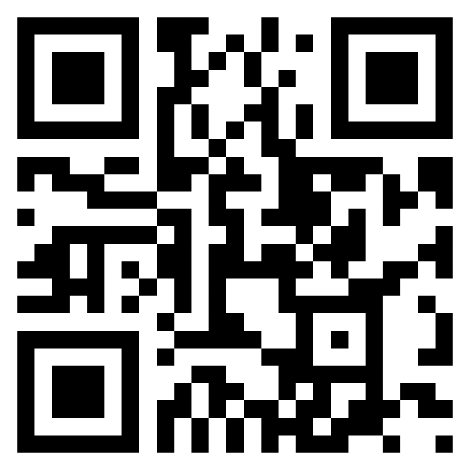
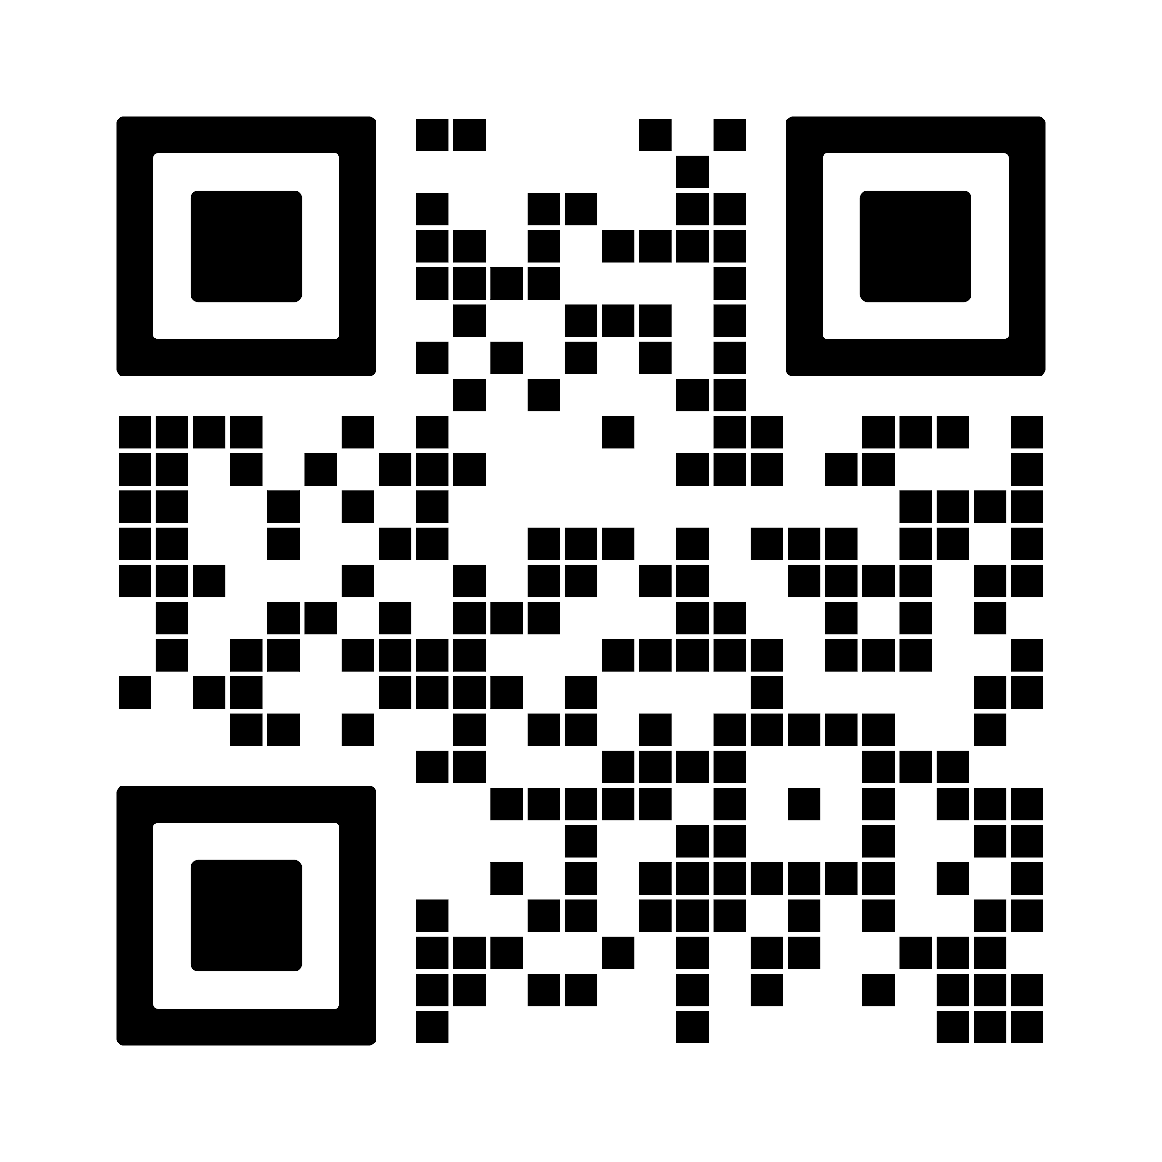
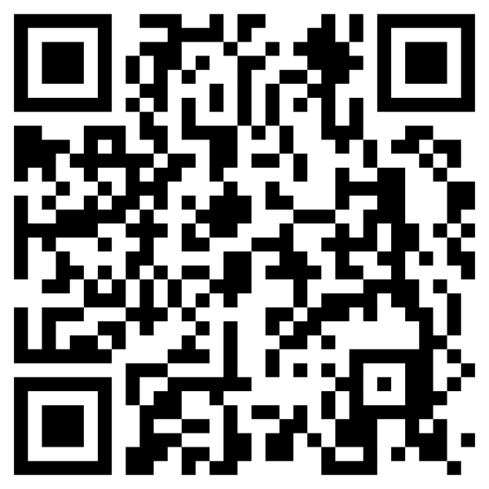




Participate in OPEA
Take Action
Learn More
OPEA Project on GitHub
OPEA
Mailing Lists
Visit OPEA.dev
Contribute
Join a Working Group
Contribute code, docs, projects, blueprints, & more
Evangelism and Promotion of OPEA in YOUR communities, events
Bring Enterprise AI use cases
Provide feedback

Slide 15
LF AI & Data Annual Dues
Not Yet a Linux Foundation Member
Existing Linux Foundation Member
Not Yet a Linux Foundation Member
Existing Linux Foundation Member
Premier Member
$120,000
$100,000
General Member
5,000 employees+: $45,000
2,000 - 4,999: $30,000
500 - 1,999: $25,000
Up to 499 employees: $10,000
5,000 employees +: $25,000
2,000 - 4,999: $15,000
500 - 1,999: $10,000
Up to 499 employees: $5,000
Associate Member
Free
Limited to academic and nonprofit institutions respectively and requires approval by the Governing Board
Note: The next three slides detail the specifics around each level of membership

Slide 16
Legal Notices
The Linux Foundation, The Linux Foundation logos, and other marks that may be used herein are owned by The Linux Foundation or its affiliated entities, and are subject to The Linux Foundation’s Trademark Usage Policy at https://www.linuxfoundation.org/trademark-usage, as may be modified from time to time.
Linux is a registered trademark of Linus Torvalds. Please see the Linux Mark Institute’s trademark usage page at https://lmi.linuxfoundation.org for details regarding use of this trademark.
Some marks that may be used herein are owned by projects operating as separately incorporated entities managed by The Linux Foundation, and have their own trademarks, policies and usage guidelines.
TWITTER, TWEET, RETWEET and the Twitter logo are trademarks of Twitter, Inc. or its affiliates.
Facebook and the “f” logo are trademarks of Facebook or its affiliates.
LinkedIn, the LinkedIn logo, the IN logo and InMail are registered trademarks or trademarks of LinkedIn Corporation and its affiliates in the United States and/or other countries.
YouTube and the YouTube icon are trademarks of YouTube or its affiliates.
All other trademarks are the property of their respective owners. Use of such marks herein does not represent affiliation with or authorization, sponsorship or approval by such owners unless otherwise expressly specified.
The Linux Foundation is subject to other policies, including without limitation its Privacy Policy at https://www.linuxfoundation.org/privacy and its Antitrust Policy at https://www.linuxfoundation.org/antitrust-policy. each as may be modified from time to time. More information about The Linux Foundation’s policies is available at https://www.linuxfoundation.org.
Please email legal@linuxfoundation.org with any questions about The Linux Foundation’s policies or the notices set forth on this slide.

