Slide 1

OPEA Community Day
July 16, 2024
Malini Bhandaru, malini.bhandaru@intel.com
Contributors: Arun Gupta, Rama Karamshetty, Zhiwei Zhang, Ke Ding, Haihao Shen, Iris Ding, Abi

Slide 2
Agenda
OPEA: What & Why?
Where are we today?
What next?

Slide 3
OPEA: What & Why?

Slide 4
GenAI is top of mind, but enterprises are struggling to unlock its value in production.

Slide 5
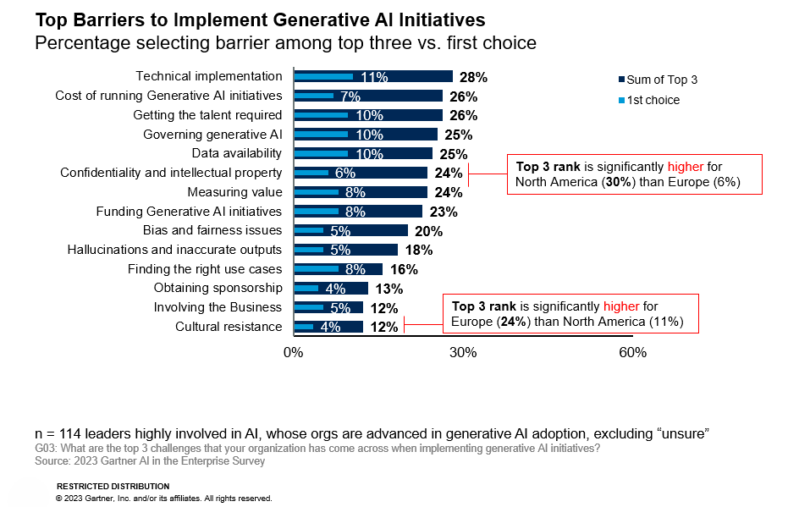

Open Ecosystems can lower barriers to productize Enterprise AI
The top barriers in implementing generative AI:
Technical Implementation, Cost, and Talent Scarcity
Source: Board Presentation: Data on Generative AI, 25 March 2024. Gartner is a registered trademark and service of Gartner, Inc and/or its affiliates in the U.S. and internationally and is used herein with permission. All rights reserved.
Notes:
When asked to rate the top barriers to implementing generative AI at scale, the leaders of enterprise organization identified a number of challenges to address. They talk of technical challenges, of governance and trust, and of the data used to train these models. And they also talk about you, about the developers who create these solutions and about having enough of you with the right skillsets. They see the value, I would think by now we all do, and they see the primary barriers to obtaining that value to be associated with how to deploy solutions that scale, on the platforms they want to invest in, and in having the people who can develop, train, and improve on these solutions.

Slide 6
Taming Ecosystem Complexity
Ease development and
production deployment
Speed return on investment
Start with existing/deployed infrastructure
Scale with new hardware
Procure new hardware quickly (short lead time)
Integrate within existing enterprise workflow
Integrate within ecosystem stack
Enable fast prototyping and agile deployment of AI apps on existing systems
Fast time-to-result (latency, throughput)
Result quality (accuracy, effectiveness)
Low hardware procurement cost
Low operational cost
Secure
End-to-end supported use cases
On-prem data center support
Virtual private cloud support
End-to-end data security
Augmented services (e.g., QnA, generation, summarization)
Defect/Anomaly detection, Theft prevention
Fraud detection, Pattern anomaly
Research & discovery
Notes:
Tie these primary needs to slide3 Gartner gaps and how we plan to address them
The ecosystem is evolving quickly; fragmentation is increasing
Enterprises challenged to roll own, when innovation is rapidly evolving
We’ve seen this movie before
Integration, Standardization, and Alignment is key

Slide 7
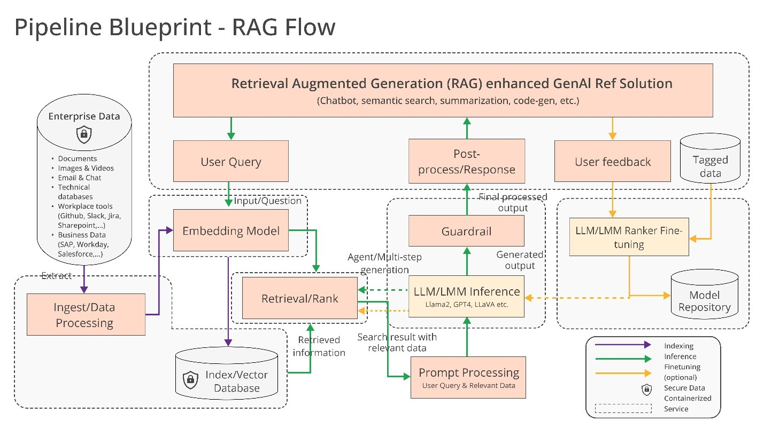
Technical Complexity
Notes:
Let’s take a deeper dive into the actual architecture of a typical LLM+RAG E2E solution.
There are 3 typical paths to solutions you see here. LLM path, LLM+RAG path, FT w/ LLM & LLM+RAG paths. This is a simplistic representation of these architecture paths. A few assumptions on this diagram here are that we are starting w/ an Open Source Model in all paths.
Walk through these paths for audience.
The ecosystem players from the previous slides are experts in one or more of these components you see in these solutions paths.
Once again as Intel, we would like to make all these components work together in open platform model. Have every component expert help contribute and use the resources we bring to the table

Slide 8
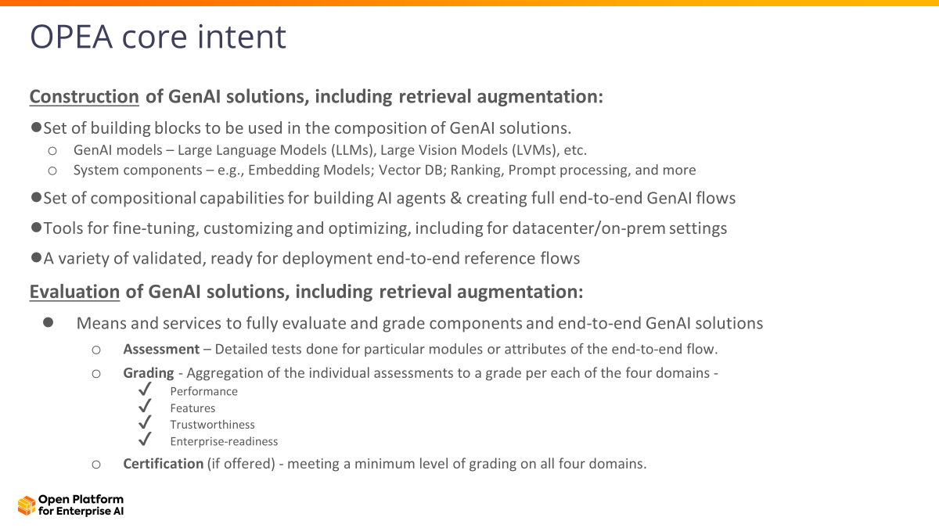

Simplify enterprise Generative AI adoption and reduce the time to production of hardened, trusted solutions
Notes:
Introducing OPEA, the Open Platform for Enterprise AI
The mission of OPEA is to create an open platform project that enables the creation of open, multi-provider, robust and composable GenAI solutions that harness the best innovation across the ecosystem.
This is an Open Platform Project under the Linux Foundation’s LF AI & Data Umbrella that enables the creation of open, multi-provider, robust and composable GenAI systems that harness the best open source innovation from across the ecosystem.
OPEA will focus on
RAG - Standardize modular, heterogenous RAG pipelines for Enterprise use
Models - Focus community on Open Model development and hardening for integration within OPEA* while supporting all Models
Compilers - Optimization of Compilers and Toolchains
Containers - Partner with CNCF AI WG to build AI Container readiness and portfolio breadth

Slide 9
Where are we today?
Code, TSC, Partners

Slide 10
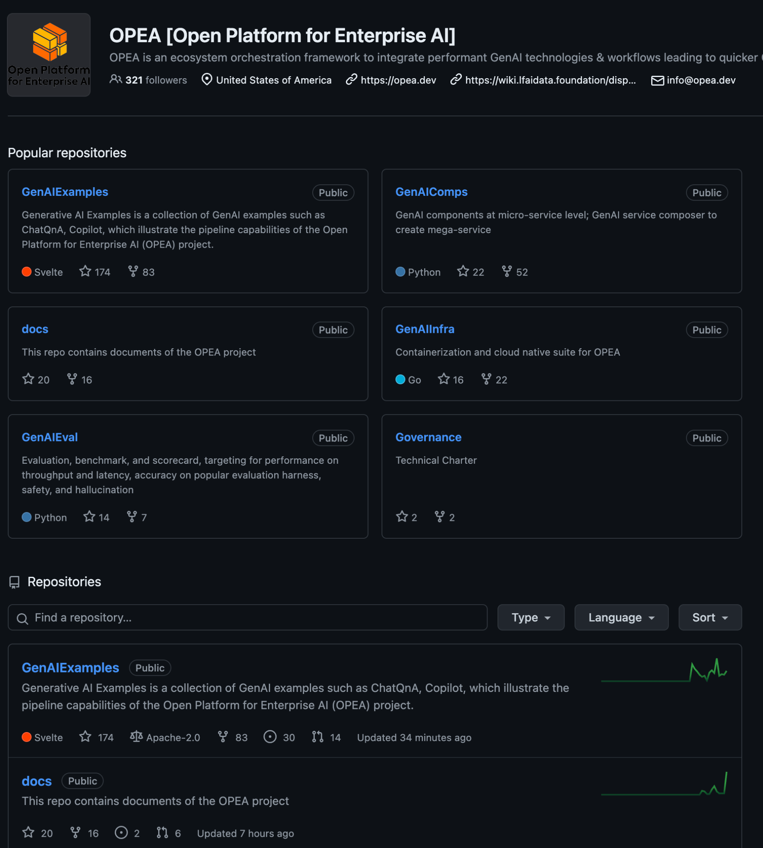
OPEA on GitHub
Notes:
Neutral Project, for anyone to access

Slide 11
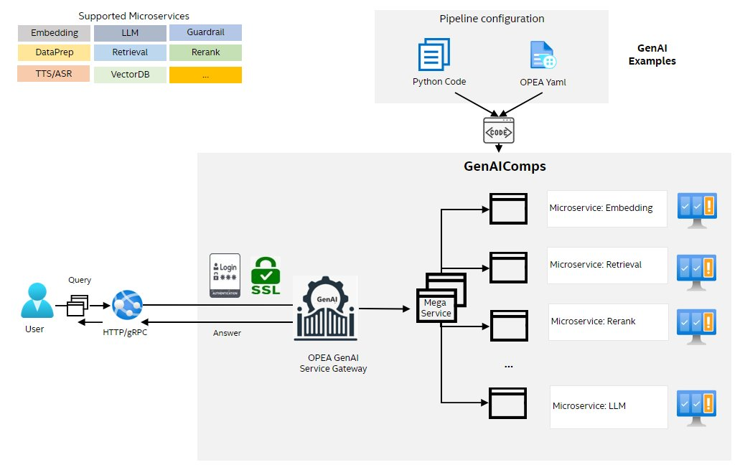
OPEA Architecture

Slide 12
OPEA Demos
Use case: ChatQnA RAG pipeline
Demos - LF AI Foundation - Confluence (lfaidata.foundation)
Intel Tiber Developer Cloud
Public Cloud
AWS EKS
Red Hat OpenShift
AI PC

Slide 13
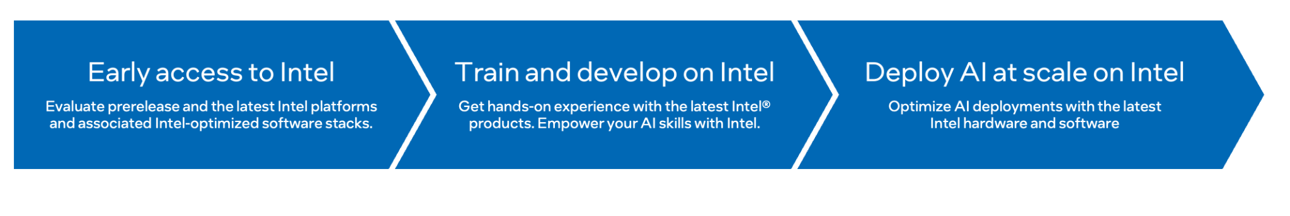
Intel Tiber Developer Cloud
cloud.intel.com

Slide 14
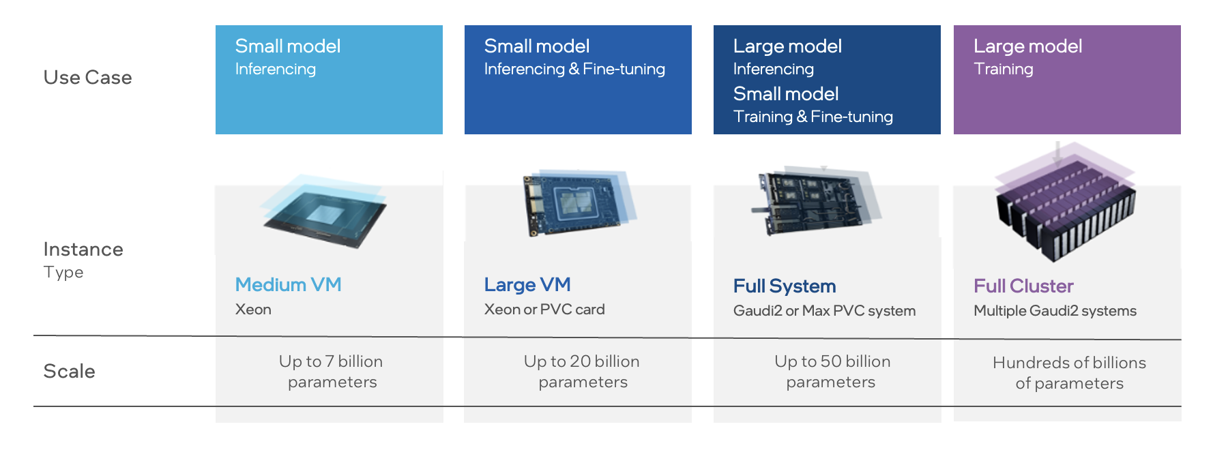
Intel Tiber Developer Cloud
AI Compute Instances

Slide 15
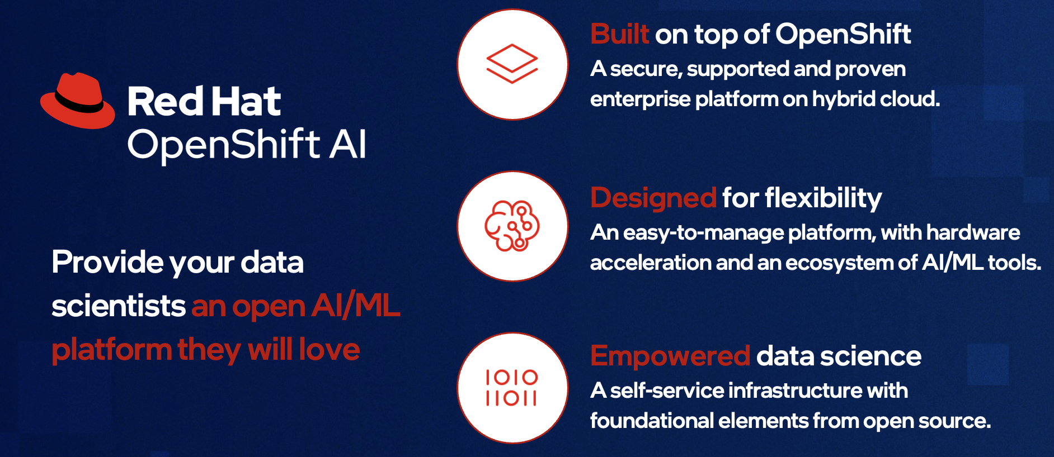
Red Hat® OpenShift® AI
More from Red Hat Partner
Notes:
Speaker: Julie

Slide 16
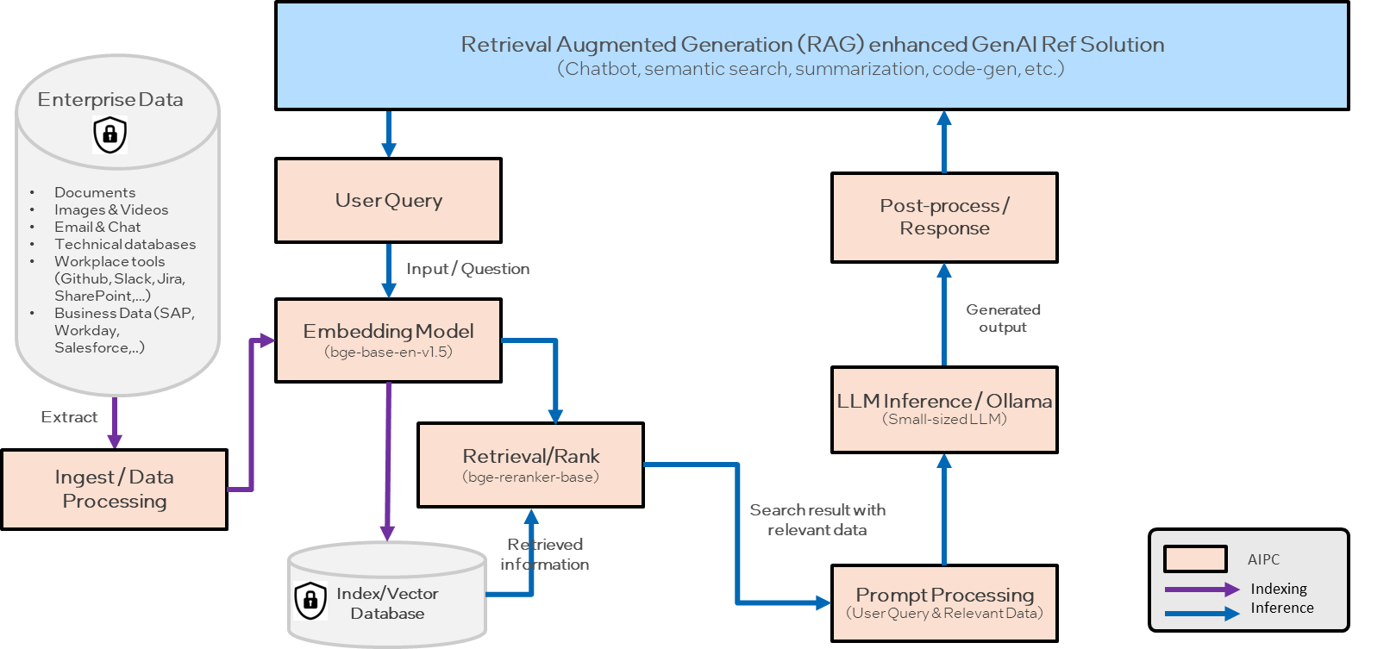
OPEA on Kubernetes
Public Cloud: AWS EKS
AWS EKS

Slide 17
Kubernetes using GenAI Micro Service Connector (GMC)
Design Goals
​Ease creation and configuration, and automate )management for GenAI applications​
Dynamic GenAI application change without disrupting user traffic
Tenant isolation (via namespaces​)
Out-of-the-box user authentication and authorization
Traffic management (A/B testing, load balancing)​
Leverages: Kubernetes Operator pattern, Custom Resource Definitions, and Service Mesh technologies.

Slide 18
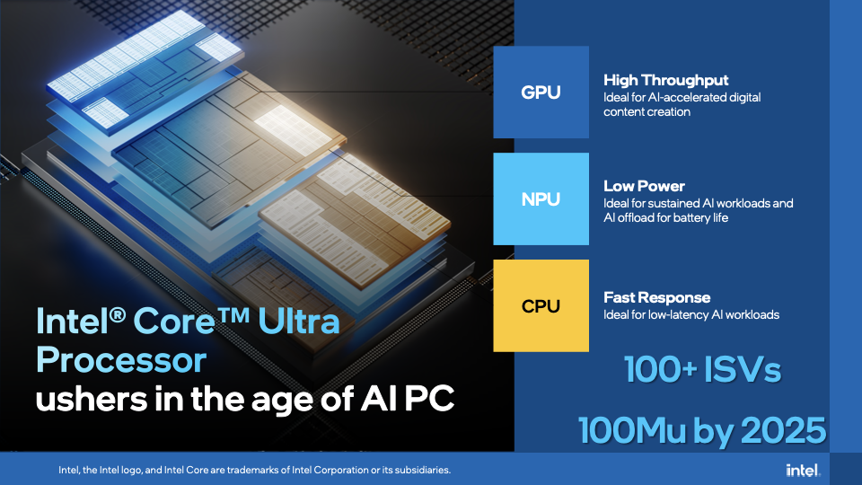
Local Development & Use
Notes:
Intel is honored to lead the AI PC transformation by making it easy for our SW ecosystem to develop and deploy new and enhanced AI experiences and provide the scale to reach the masses.
AND it ALL starts with our new Core Ultra Processor
We launched it back in December in NYC and we are very excited about this platform!
Our Core Ultra has a NEW integrated Neural Processing Unit (NPU) to go along with our CPU and GPU
EACH of these processors bring unique strengths spanning fast response time, high throughput, and low power
This enables ISVs and SW developers to match the right workload with the right XPU to deliver the BEST user experience
Our Core Ultra is also up to 36% more power efficient vs our prior generation AND delivers 2X the gaming performance
It also includes Thunderbolt 4 and WiFi 7 AND up to 70% faster generative AI performance taking advantage of our GPU and NPU
And to bring this to the market, we work closely with the Top 100 ISVs so their SW applications can benefit from faster performance, lower power consumption and most importantly scale on 100 Million AI PCs we will drive by 2025

Slide 19
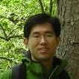
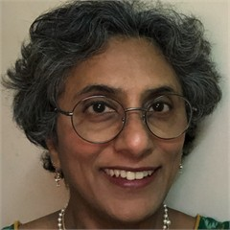
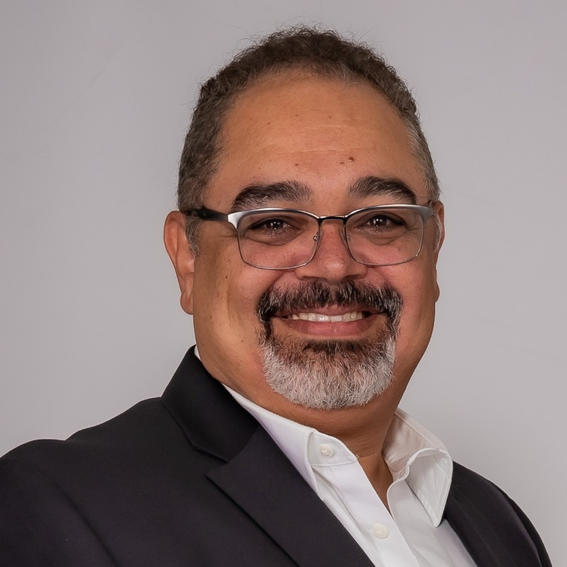

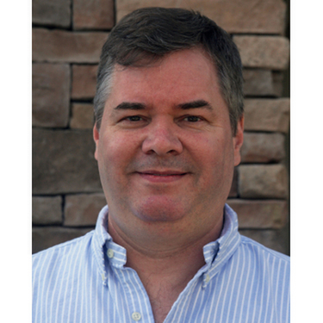
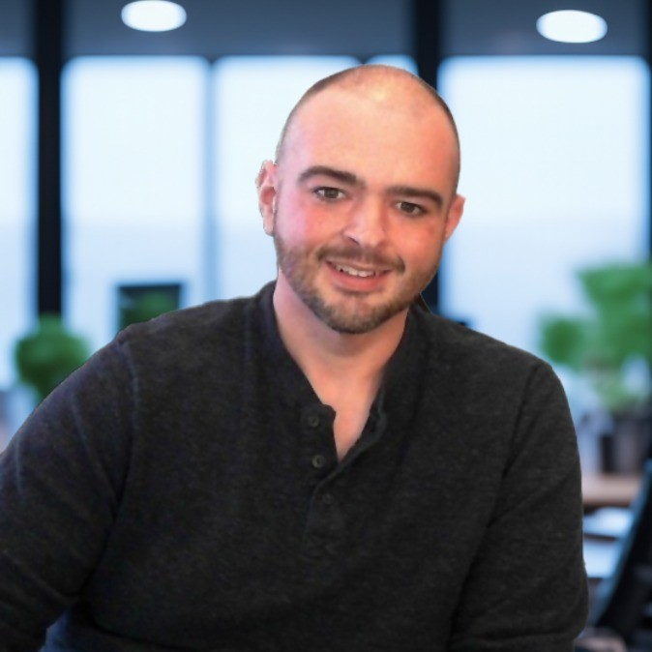
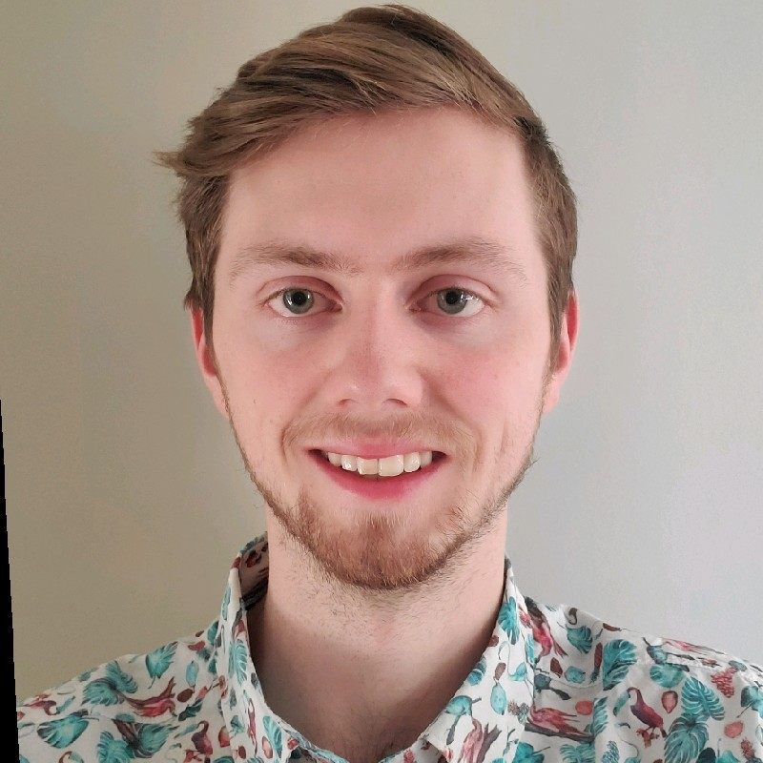
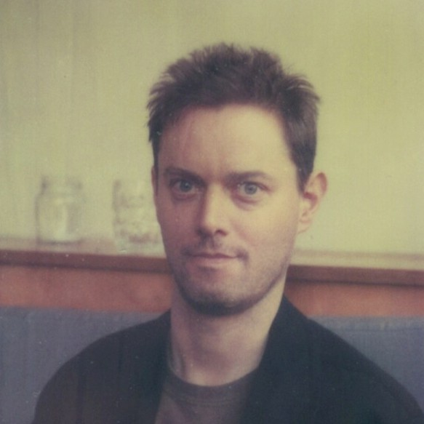
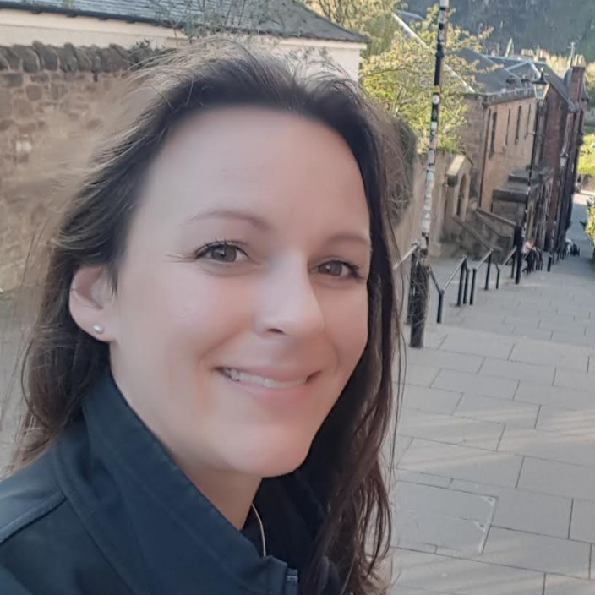
Technical Steering Committee
Ke Ding
Senior Principal AI Engineer
Intel Corporation
Malini Bhandaru (Chair) Senior Principal Cloud Architect
Intel Corporation
Amr Abdelhalem
SVP, Head of Cloud Platforms
Fidelity Investments
Robert Hafner
Senior Principal Architect
Comcast
Steve Grubb
Senior Principal Engineer, Red Hat
Nathan Cartwright
Chief Architect, AI
CDW
Logan Markewich
OSS Lead
LlamaIndex
Justin Cormack
Chief Technology Officer, Docker
Melissa Mckay
Head of Developer Relations
JFrog Inc

Slide 20
TSC Responsibilities
coordinating the technical direction of the Project;
approving project or system proposals (including, but not limited to, incubation, deprecation, and changes to a sub-project’s scope);
organizing sub-projects and removing sub-projects;
creating committees or working groups (for example, an executive or architectural committee or end-user advisory committee) to support the Project;
appointing representatives to work with other open source or open standards communities;
establishing community norms, workflows, issuing releases, and security issue reporting policies;
approving and implementing policies and processes for contributing (to be published in the CONTRIBUTING file) and coordinating with the series manager of the Project (as provided for in the Series Agreement, the “Series Manager”) to resolve matters or concerns that may arise as set forth in Section 7 of this Charter;
discussions, seeking consensus, and where necessary, voting on technical matters relating to the code base that affect multiple sub-projects; and
coordinating any marketing, events, or communications regarding the Project.

Slide 21
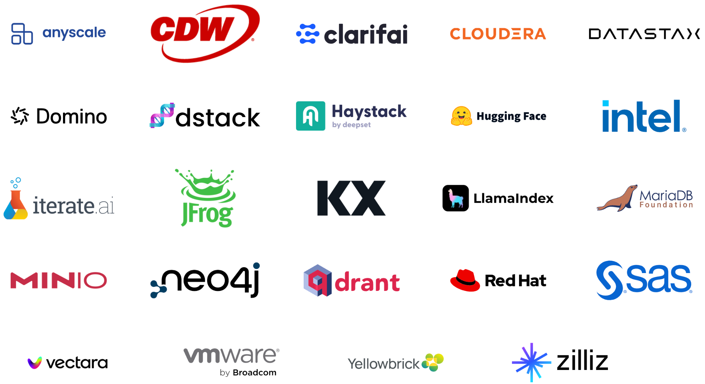
OPEA Partners
Partners as of July 3, 2024
Notes:
Updated 6/10

Slide 22
What Next?

Slide 23
Roadmap (months)
Near Term
Polish documentation, test on additional platforms, develop agent foundation, AuthN & Z, smart routing
Mid Term
Benchmarking, evaluation, otpimizations, agents, additional micro-components and use cases, observability, service mesh support, confidential compute
Long Term
More partner contributions, vertical use cases

Slide 24







OPEA Next Steps
Take Action
Refine and expand project plans
Learn More
Get Involved!
OPEA Project on GitHub
OPEA Wiki
Visit OPEA.dev
Contribute
Join the project
Contribute code, docs, projects, blueprints, & more
Bring Enterprise AI use cases
Provide feedback
Evangelise and Promote OPEA in YOUR communities, events
Notes:
Join the project (Does not have to join LF AI & Data Foundation)
Contribute assets (code, docs, use cases, projects, blueprints)
Bring customer use cases

Slide 26
Backup

Slide 27
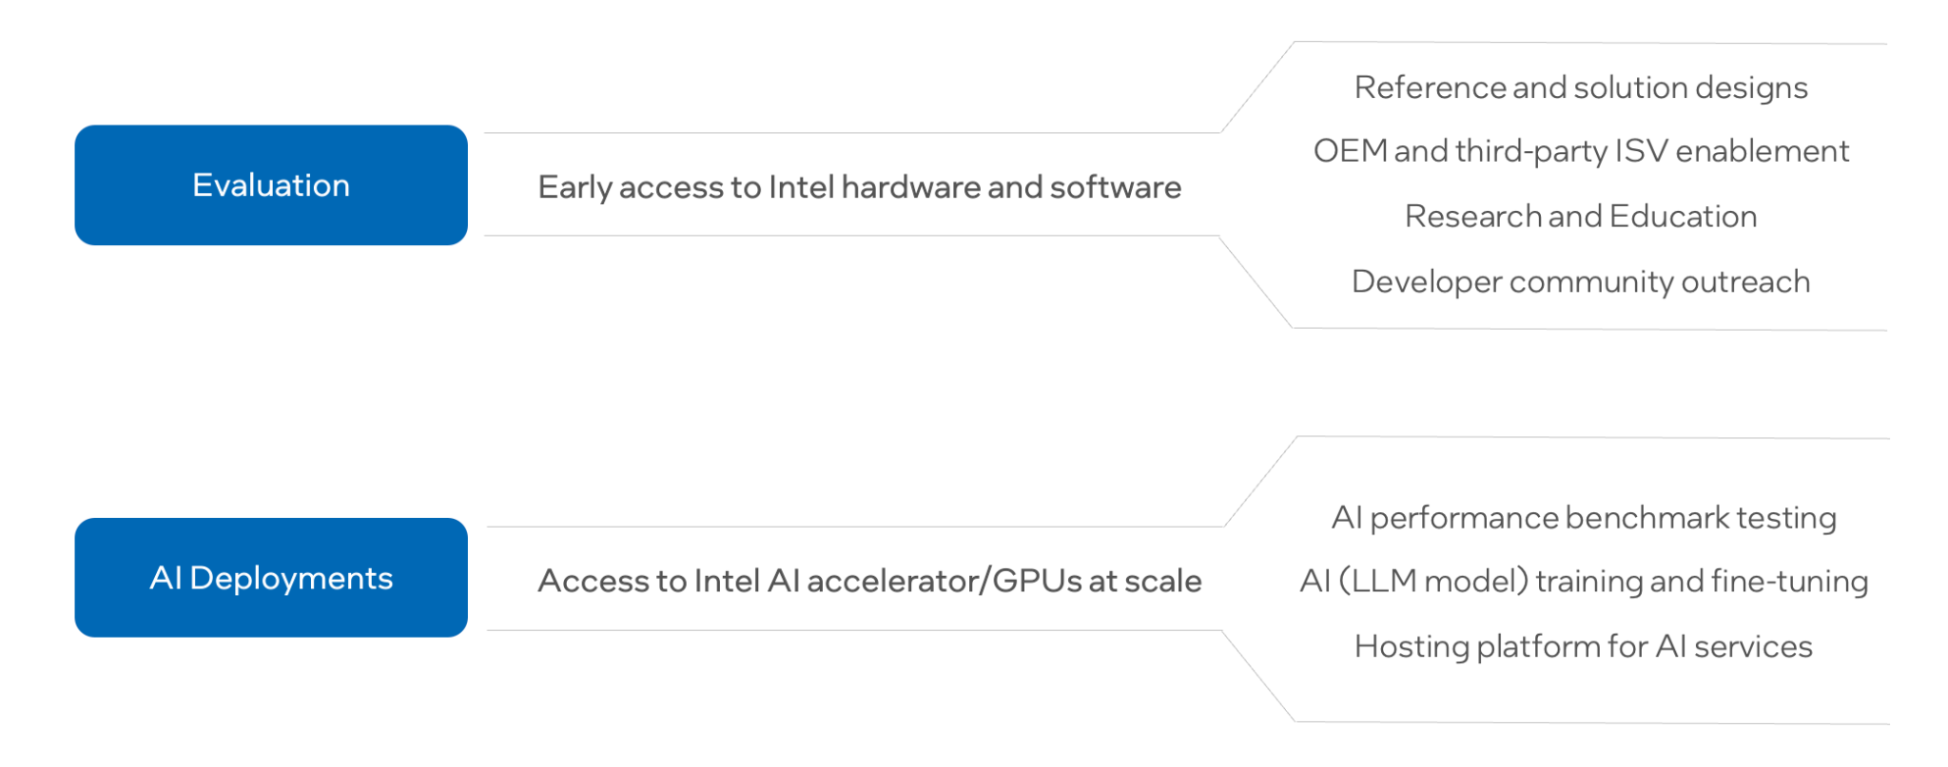
Intel Tiber Developer Cloud
Cloud Services for AI

Slide 28
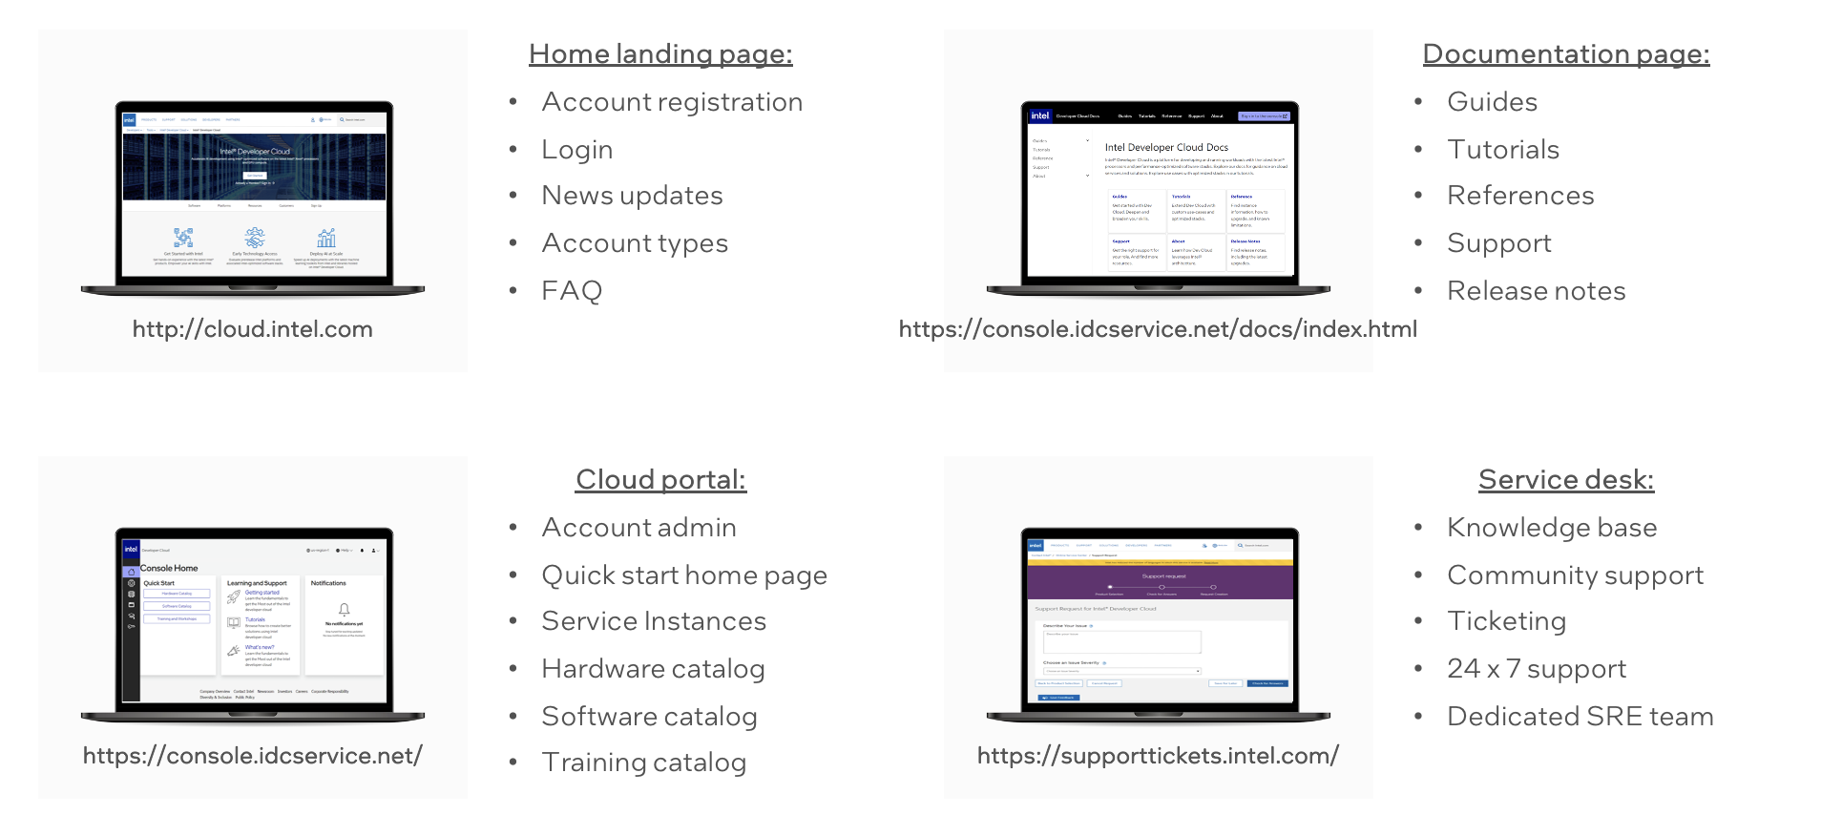
Intel Tiber Developer Cloud
User Experience

Slide 29
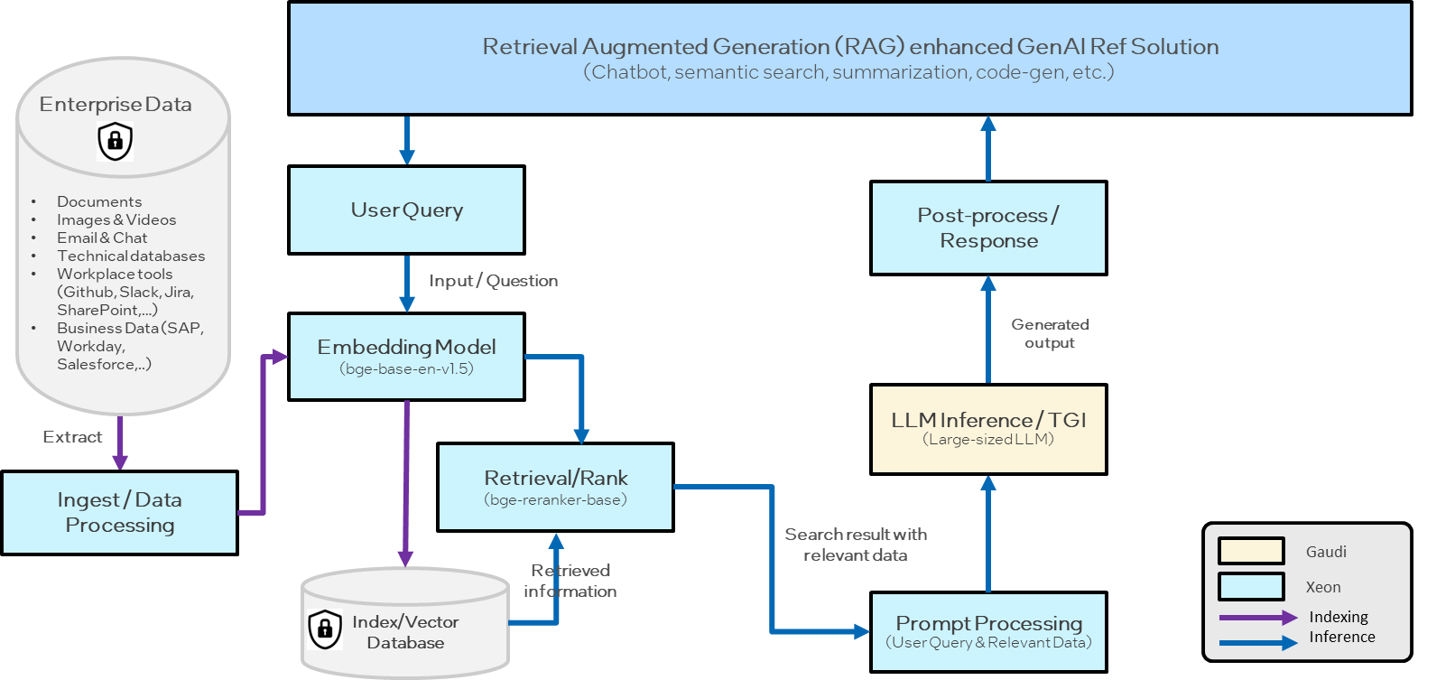
Enterprise AI on Intel Tiber Developer Cloud Demo

Slide 30
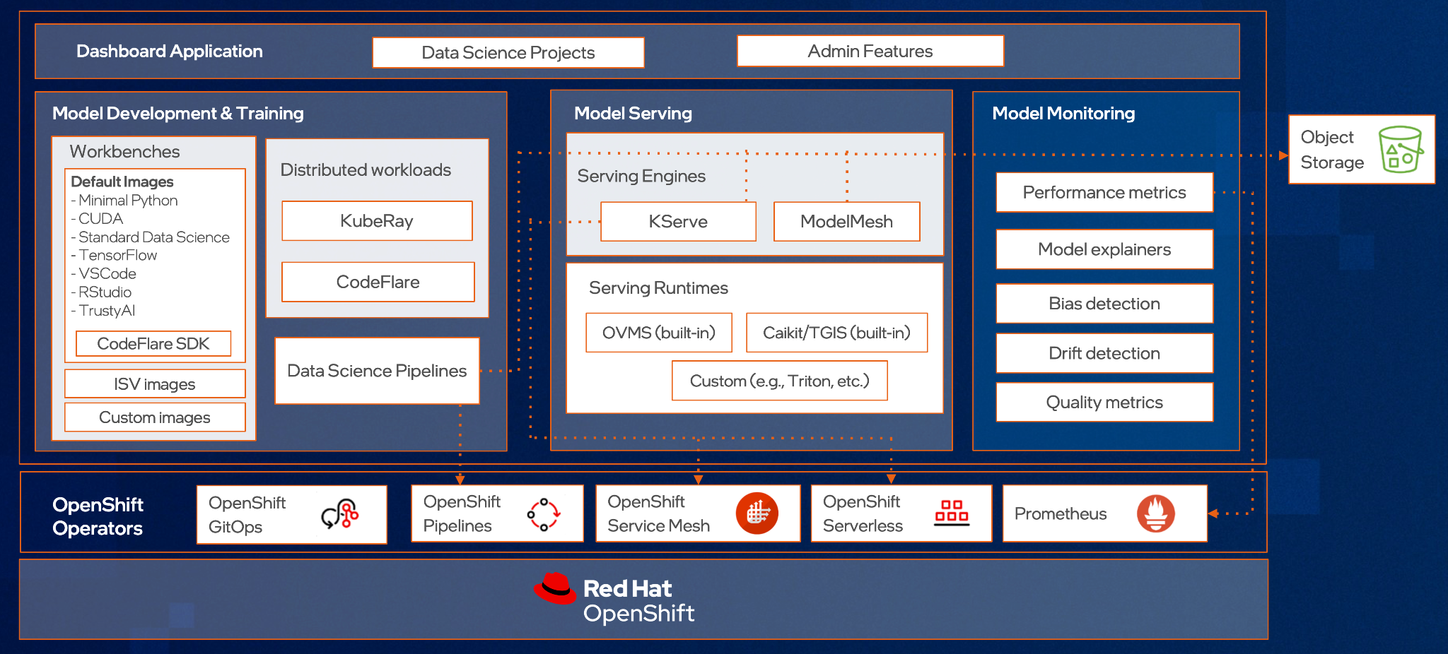
Red Hat® OpenShift® AI Components
Notes:
Speaker: Julie

Slide 31
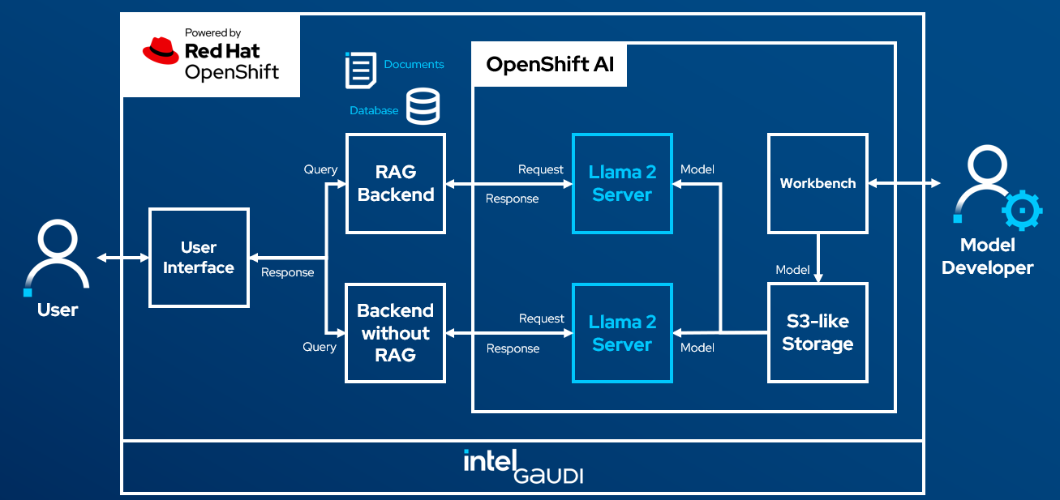
Red Hat® OpenShift® AI Demo
Notes:
Speaker: Julie

Slide 32
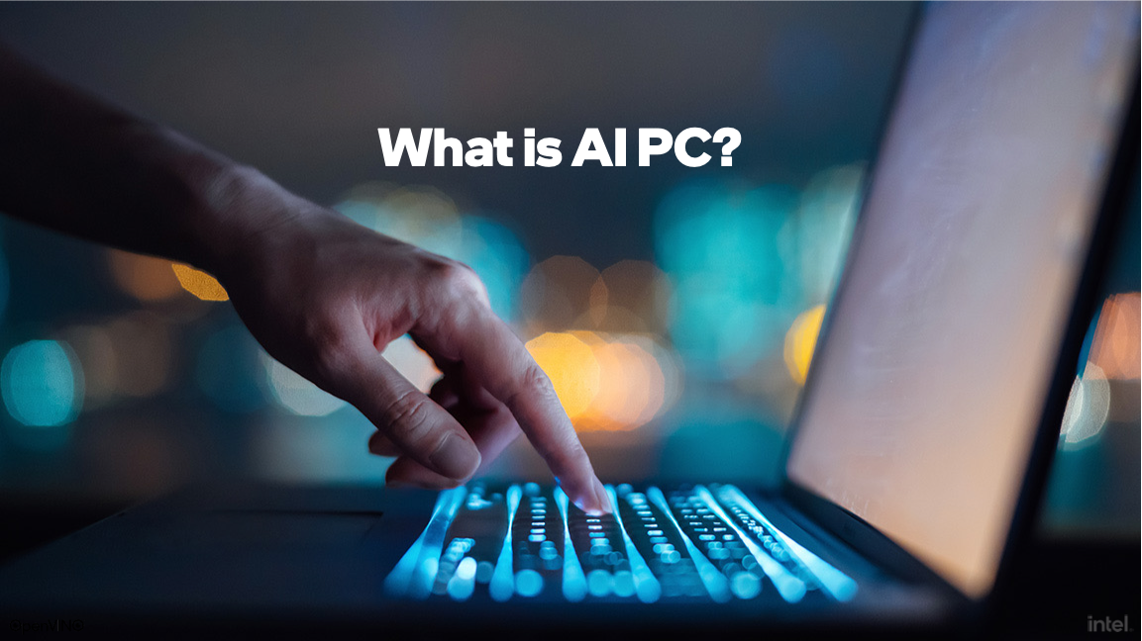

Slide 33
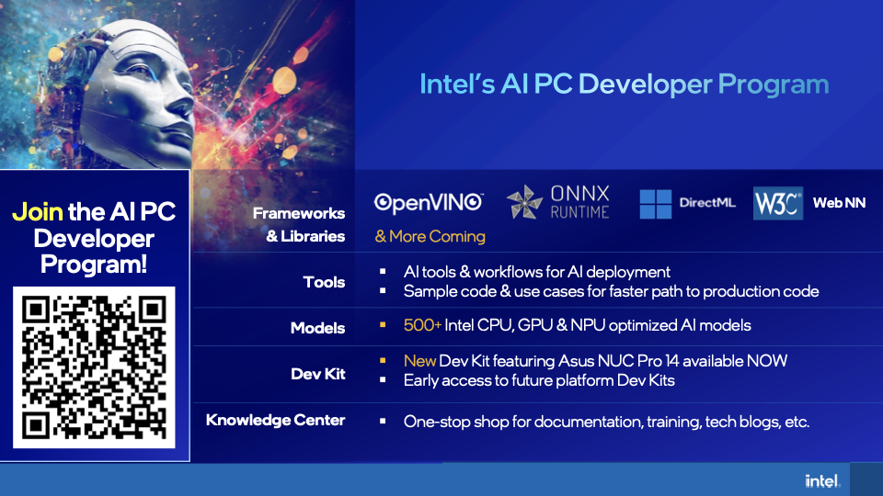
Notes:
To accelerate the AI PC SW ecosystem development, we launched the AI PC developer program in March. The program is focused on developers, who are a critical piece in helping drive new and innovative usages, features & experiences for AI PCs.
We are drawing from years of experience working with developers to ensure they have what need to unlock even more SW benefits on an AI PCs.
Our goal is to accelerate application development, provide them w/key resources & drive a consistent, seamless and frictionless experience
Our developer program centers around a few things:
·It offers Choice amongst Frameworks & Libraries: ranging from OpenVino, ONNX Runtime, DirectML, & WebNN and more coming soon!
·Tools: and workflows for AI deployment, with sample code and use cases so that developers see a faster path to production code.
·Models that are optimized across Intel’s CPU, GPU and NPU so that the right workload runs on the right xPU.
·And at last count, we added up 500 optimized models: Intel’s OpenVINO open model zoo has over 280 open-source and optimized pre-trained models.
·Over 160 out of the 173 models in the ONNX model zoo work natively through ONNX OpenVINO EP (execution provider).
·And over 150 models posted on Hugging Face, including LLMs, Embedding, Vision, 3D, and Multi-Modal models. Our most popular models have over 300K downloads per month. And they are all at no cost to developers!
·A key part of our Developer Program includes access to a Dev Kit – Featuring the Asus NUC Pro 14 which is available NOW! And early access to upcoming dev kits on future platforms. These dev kits are AI ready with a pre-installed SW stack, drivers and a host of other programing tools and compilers to get developers going.
·And last, our knowledge center, a one stop shop that builds on our legacy of key information and training content and is now updated with our latest news for developers.

Slide 34
Enterprise AI on AI PC Demo

